Slide 1
Elementos de nanobiomecanica

Slide 3
Living cells in the human body are constantly subjected to mechanical stimulations throughout life.
These stresses and strains [tensiones y deformaciones] can arise from both the external environmental and internal physiological conditions.
Depending on the magnitude, direction and distribution of these mechanical stimuli, cells can respond in a variety of ways.
1 For example within the body, fluid shear [shear: pelar-rapar: fluid shear”raspado”] of endothelial cells activate hormone release and intracellular calcium signaling as well as stiffen the cells by inducing rearrangement of the cytoskeleton
Experimental setup and human umbilical vein endothelial cell (HUVEC) morphology. A: schematic of the experimental system used to exert a steady
laminar fluid flow of 1 Pa on HUVEC monolayers. B: phase-contrast image of a representative micropatterned HUVEC monolayer (1.5 mm diameter). Within the interior of this monolayer, a 500 500 m square area was used to analyze cell body and intercellular stress orientations. C–E: phase-contrast images of HUVECs in static conditions at 0 h (C), 12 h (D), and 24 h (E) display a cobblestone morphology with no preferred orientation. F–H: HUVEC morphology at the onset of laminar fluid shear displayed a cobblestone morphology with no preferred orientation (F); however, cell body elongation and alignment along the fluid flow direction was observed between 12 h (G) and 24 h (H) of steady laminar fluid shear. Scale bars, 100 m.
Fluid shear, intercellular stress, and endothelial cell alignment Robert Steward, Jr.,1 Dhananjay Tambe,2 C. Corey Hardin,3 Ramaswamy Krishnan,4 and Jeffrey J. Fredberg1Am J Physiol Cell Physiol 308: C657–C664, 2015.

Slide 4
2 The mechanical compression of cells such as chondrocytes are known to modulate proteoglycan synthesis
Articular cartilage resides in a complex and dynamic mechanical environment in vivo, characterized by compressive and shear stresses along multiple axes and hydrostatic and osmotic pres-sures throughout. The biomechanical environment, in part, governs the development and maturation of the native structural architecture through a classical structure–function relationship. The heterogeneous and anisotropic extracellular matrix of mature tissue exhibits complex biomechanical properties, including biphasic viscoelasticity and strain stiffening behavior, and the tissue is avascular to accommodate dynamic loading. Without a blood supply, articular cartilage lacks the ability for intrinsic repair following disruption of tissue structure and alterations in the mechanical environment during injury.
Anderson DE and Johnstone B (2017) Dynamic Mechanical Compression of Chondrocytes for Tissue Engineering: A Critical Review. Front. Bioeng. Biotechnol. 5:76.

Slide 5
3 The tensile stretching of cell substrate can alter both cell motility and orientation
Cell structure depends on both matrix strain and stiffness, but their interactive effects are poorly understood. We
investigated the interactive roles of matrix properties and stretching patterns on cell structure by uniaxially stretching U2OS cells expressing GFP-actin on silicone rubber sheets supporting either a surface-adsorbed coating or thick hydrogel of type-I
collagen. Cells and their actin stress fibers oriented perpendicular to the direction of cyclic stretch on collagen-coated sheets, but oriented parallel to the stretch direction on collagen gels. There was significant alignment parallel to the direction of a steady increase in stretch for cells on collagen gels, while cells on collagen-coated sheets did not align in any direction. The extent of alignment was dependent on both strain rate and duration. Stretch-induced alignment on collagen gels was blocked by the myosin light-chain kinase inhibitor ML7, but not by the Rho-kinase inhibitor Y27632. We propose that active orientation of the actin cytoskeleton perpendicular and parallel to direction of stretch on stiff and soft substrates, respectively, are responses that tend to maintain intracellular tension at an optimal level. Further, our results indicate that
cells can align along directions of matrix stress without collagen fibril alignment, indicating that matrix stress can directly
regulate cell morphology.
Tondon A, Kaunas R (2014) The Direction of Stretch-Induced Cell and Stress Fiber Orientation Depends on Collagen Matrix Stress. PLoS ONE 9(2): e89592

Slide 6
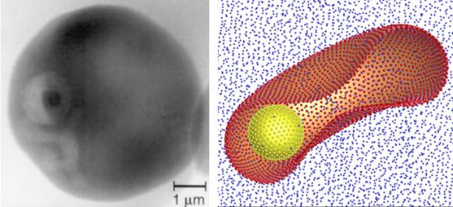
many biological processes, such as growth, differentiation, migration, and even apoptosis (programmed cell death) are influenced by changes in cell shape and structural integrity
any deviation in the structural and mechanical properties can result in the breakdown of these physiological functions and may possibly lead to diseases.
https://news.brown.edu/articles/2010/12/malaria
4 Red blood cells transport oxygen to the various parts of the human body by deforming their way through blood vessels and narrow capillaries.
Unfortunately, these cells are also coveted by the protozoan Plasmodium falciparum, the single-cell parasites that cause malaria. These parasites cause extensive molecular and structural changes which stiffen the cell membrane resulting in the impairment of blood flow, possibly leading to coma and even death
Less elastic, more viscousThe malaria parasite inside a red blood cell, left, and in a computer-generated model. Malarial infection inhibits the smooth flow of blood through capillaries.

Slide 7
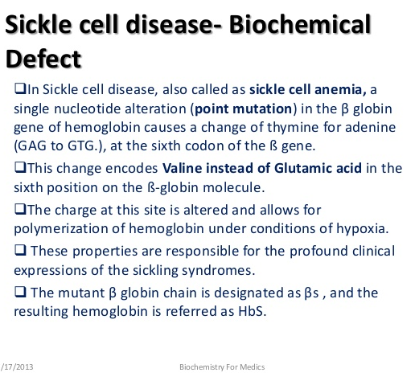
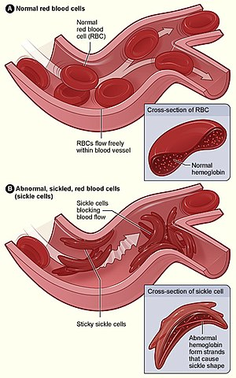
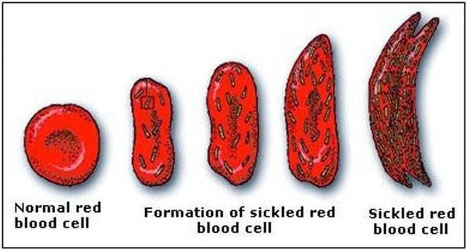

Slide 8
5 Another example that relates to immunology is the formation of a concentrated or marginated pool of neutrophils in the pulmonary capillary blood and is thought to play an important role in host defense. This happens because of a delay in the transit of neutrophils through the capillary as compared with that of red blood cells. The spherical neutrophils that are larger than the red blood cells take a longer time to deform and pass through the narrow capillary. Therefore, the deformability of single blood cells can greatly influence the rheological properties of blood
Neutrophil influx in ARDS. In patients with acute lung injury from ARDS, resident lung cells such as macrophages secrete chemokines that induce neutrophils or polymorphonuclear cells (PMN) to migrate from the bloodstream into the airspaces. Classically, neutrophil migration has been thought to be driven by CXC chemokines, with CXCL8 being the protypical neutrophil chemokine, inducing migration by acting on its receptors, mainly CXCR1 in humans. Chambers et al have demonstrated that two members of the CC family of chemokines, CCL2 and CCL7, are upregulated in the lungs of patients with ARDS. Their receptor, CCR2, is upregulated on neutrophils as they migrate from the vasculature into the airspaces, while CXCR1 is downregulated. Moreover, these CC chemokines act in synergy with CXCL8 to induce neutrophil influx. As neutrophils migrate into the lungs, they become activated, releasing toxic mediators such as reactive oxygen species (ROS), proteases and neutrophil extracellular traps (NETs), which function to kill invading pathogens but also may cause epithelial and endothelial injury, leading to the development of protein-rich alveolar oedema.

Slide 9
Apart from mechanical loads induced within or outside the body, many chemicals are also known to increase or decrease the mechanical properties of living cells:
chemotactic agent f-Met– Leu–Phe (fMLP) can increase the stiffness of neutrophils
cytochalasin D and latrunculin B can disrupt the actin filament cytoskeleton and adversely affect the stiffness of cells
colchicines can disrupt the microtubules in the cytoskeleton of neutrophils
although this will not significantly affect the mechanical properties as actin filaments are still the primary structural elements
Finally, it is known that the mechanical properties of individual cells can determine the structural integrity of whole tissues arising from the mechanical interactions between cells and the surrounding extracellular matrix (ECM)
On the other hand, mechanical loads exerted at the tissue level are transmitted to individual cells and can influence their physiological functions C.T. Lim et al. / Journal of Biomechanics 39 (2006) 195–216

Slide 10
Elementos de nanobiomecanica:Fuerzas en Biologia
Artificial manipulation of atoms, molecules, cells, and tissues of our body is essentially the subject of ‘Nano-biomechanics’
For the manipulation of such bodily objects in a distant future, we need to know the physical properties of the materials that make up our body. Since our body functions more like a mechanical device rather than an electronic computer, we investigate the mechanical properties of the bodily components, namely, proteins, nucleic acids, polysaccharides, lipid assemblies, biomembranes, cells and so on by using the state-of-the-art technologies available to us at the present stage.
It is especially important to realize that the most abundant bodily components, proteins, are electrically nonconductive, and therefore the information transfer within and between protein based structures is mainly conducted through their mechanical deformations.
Mechanical manipulation is performed with an application of force to the sample objects.
Force is something that can be felt and is a more familiar concept than thermodynamic functions such as enthalpy or entropy. We will deal with the effect of force on very small scale because we will be talking about atoms and molecules, and eventually about living cells that are still less than 1mm in size. Atoms are very strongly built of protons, neutrons, and electrons and will not break down in our body, except for a tiny fraction of radio isotopes. Molecules are clusters of atoms bonded together by covalent bonds, which are also quite strong and difficult to break, but are much weaker compared with the force operating at the nuclear level. Molecules can be converted from one form to another by creating, breaking, and/or exchanging covalent bonds, often, with the help of a catalyst. Catalysts, when used in industry, convert nitrogen gas into ammonia in one notable example, and in the living organisms tens of thousands of them are at work, converting food stuff into the parts of our body and into energy to be consumed for our daily activity
Catalysts in our body are called enzymes. One of them, called invertase, binds a sugar molecule, for example, and converts it into glucose and fructose by breaking the covalent bond connecting them in the original sugar molecule. Binding a specific substrate molecule from among millions of similarly looking molecules is the most important first step for any enzyme.
Binding in this case is promoted by weaker forces associated with ‘noncovalent interactions’ or ‘noncovalent bonds’.
Our bodily movements and actions are the result of these noncovalent interactions between and among tens of thousands of molecules in our body.

Slide 11

Human Body and Force Gravity and hydrodynamic force
Gravity: We feel force by the sensation to the muscles of our body when we lift a weight against the gravity, or when we suddenly accelerate our car, for example. Since force is the product of mass (m) and acceleration (a), we feel it when the car is accelerating, but do not feel it when the vehicle is gliding at a constant speed (i.e., when a = 0). When we ride a roller coaster, we feel gravitational as well as centrifugal force as the coasting car swishes around sharp corners.
We also feel force as a shock when someone suddenly pushes us from behind. A sudden application of a force as described in the above case is called an ‘impact’. Force is, thus, something that can be felt as a bodily sensation when we are pushed around.
We feel the gravity of the earth because we, with a big and heavy body, live in air which has much less density than our body.

Slide 12
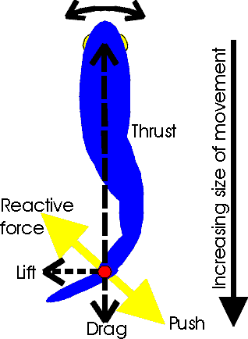
Hydrodynamic force: If you live in water like whales and fishes do, you probably don’t feel the gravity that much because the gravitational force is largely compensated by the flotation effect in water. As you go down the scale to much smaller levels, you encounter the life without the sensation of gravitational pull. Bacteria, for example, swim around up and down, left and right without feeling much of the gravitational pull. They feel a much more strong effect of viscosity of water. As the scale of your body becomes small, viscosity effect becomes predominant compared with the inertial effect of mass.
The Reynolds number (Ry-N_{R}) gives a rough estimate of the relative effects of inertial force versus viscous force
where ρ,R,v, and η are the density, the characteristic size and the velocity of the moving body, and the viscosity coefficient of water, respectively. If the Reynolds number is approximately less than 2000, the flow pattern around the moving body is smooth without any turbulence and called a laminar flow, whereas when Ry > 2000, the flow tends to be turbulent. In both cases of flow, the moving body experiences inertial resistance as it pushes a body of water aside and viscous resistance from the water sticking to the entire body surface. In a turbulent flow, the moving body must experience a drag force due to an eddy current (corriente de Foucault= corriente parasita)

Slide 13
Nuevos fenómenos que ocurren en la nanoescala: ya que los organismos vivos son 70 % de su peso agua* entonces es importante saber que…
* http://bionumbers.hms.harvard.edu/bionumber.aspx?id=108816
La vie en nano

Slide 14
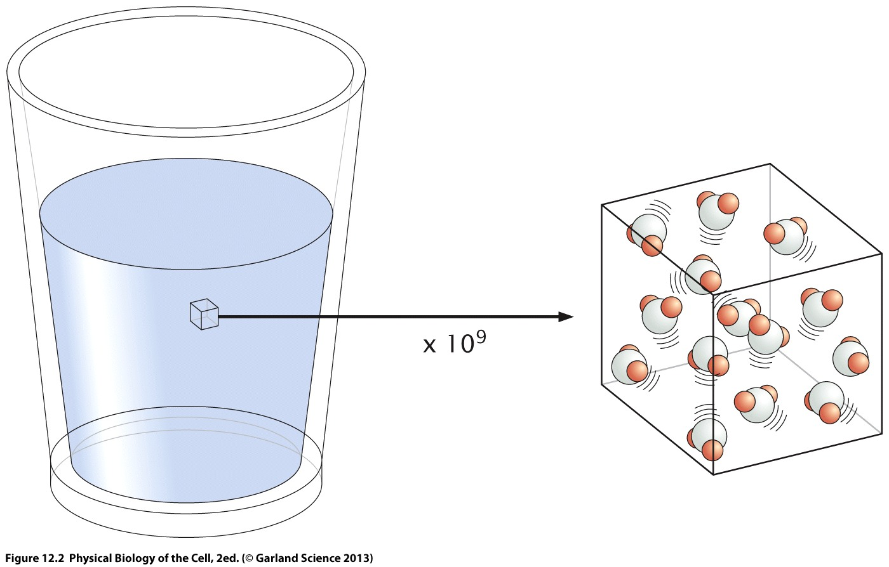
El agua se siente diferente en la nanoescala
A pesar de estar compuesta por moléculas, el agua puede considerarse como un medio continuo, sin estructura interna, es decir como un fluido.
La vie en nano

Slide 15
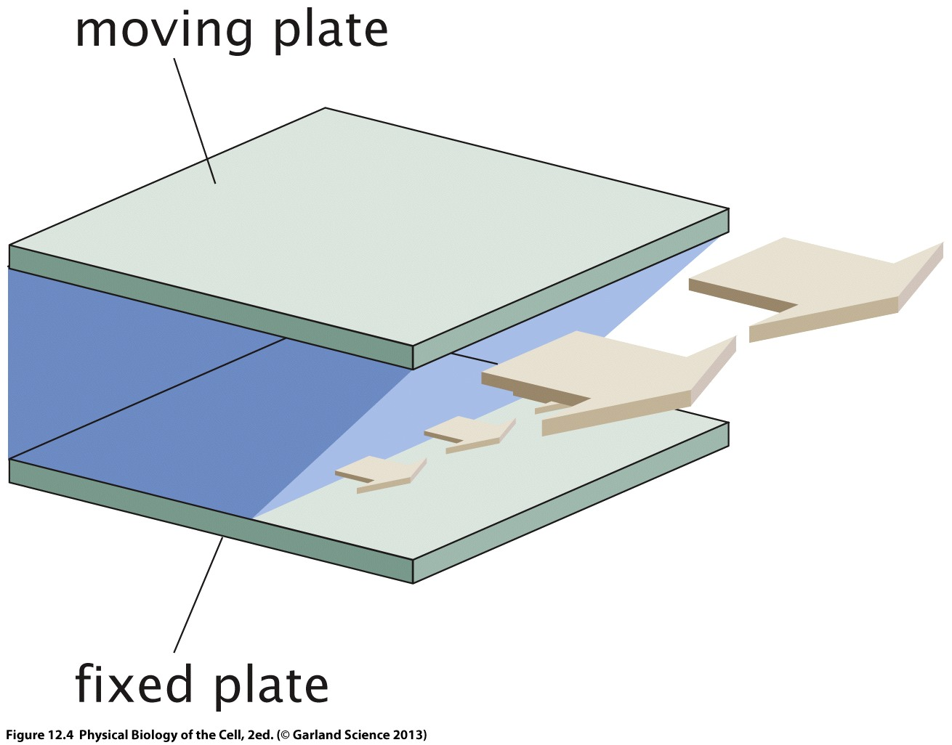
El agua se siente diferente en la nanoescala
Placa móvil de área A moviéndose a una velocidad v ante la aplicación de una fuerza F
Fluido newtoniano
F/A= η v/ d
Se establece un gradiente lineal de velocidad: el fluido en contacto con cada placa tiene su misma velocidad
Shear stress
tension tangencial
Shear rate
tasa de corte
d: distancia entre placas que separan un fluido
La viscosidad = η es un parámetro de los fluidos que describe sus propiedades materiales; equivale al modulo de Young de los solidos
η de un fluido mide su resistencia a fluir en capas bajo la aplicación de una fuerza.
η origina el arrastre que experimenta un objeto en movimiento a través de un fluido.
Unidades η (SI):
N/m2= Pascal = 10³ cPoise
Placa fija
La vie en nano

Slide 16
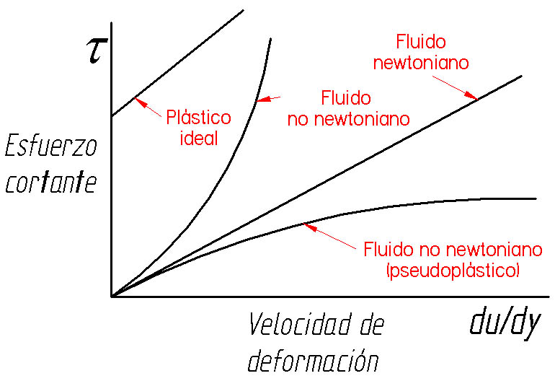

Slide 17
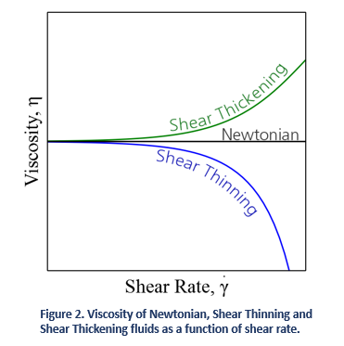

Slide 18
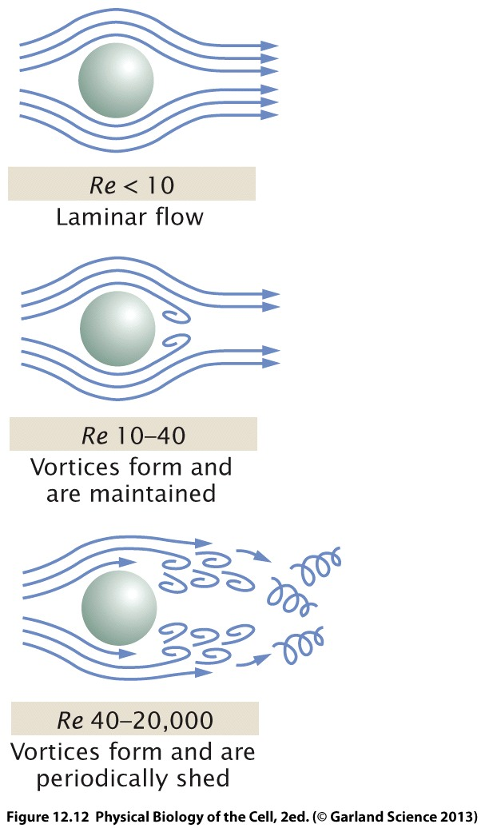
El agua se siente diferente en la nanoescala
Irreversibles
Gran intercambio de masa
Turbulentos: N_{R} ↑↑↑↑
Laminares: N_{R} ↓↓↓↓
N_{R} permite clasificar a los flujos como
Reversibles
En laminas que no se mezclan, hay intercambio molecular entre ellas
La vie en nano

Slide 19
El agua se siente diferente en la nanoescala
Los fluidos se caracterizan por el numero adimensional de Reynolds (N_{R}), que se deriva de la ecuación de Navier-Stokes (en la condición especial de eliminación del termino no lineal, para fluidos dominados por la viscosidad)
Inercia: Propiedad de un objeto de permanecer a velocidad constante (a menos que una fuerza actúe sobre el)
fuerzasinercia
↑inercia: objeto difícil de frenar (o de poner en movimiento)
↓inercia: objeto sencillo de frenar (o de mover casi instantáneamente)
N_{R} =
fuerzasfricción
ALTOS
BAJOS : la energía cinética de un elemento de fluido es rápidamente disipada por la fricción
N_{R}
f:Fuerza externa al fluido
Otra forma de interpretar N_{R} es:
N_{R} α
fc:Fuerza critica viscosa =[η]²/δ
La vie en nano

Slide 20
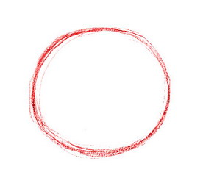
El agua se siente diferente en la nanoescala
El N_{R} puede calcularse tanto a un fluido en una tubería como a un objeto (macroscópicos o microscópicos como microrganismos, células…moléculas moviéndose en el agua o la sangre)
radio del objeto o de la tubería
densidad del fluido
N_{R} = (densidad x velocidad x tamaño)/viscosidad
N_{R} = (δ. ν . r )/η
viscosidad del fluido
velocidad del objeto o del fluido
>>>1: flujo turbulento: la inercia predomina sobre la viscosidad
nadadores macroscópicos
f
N_{R} α
fc
<<<1: flujo laminar: (“pegajoso”)la viscosidad predomina sobre la inercia
nadadores microscópicos NANOMUNDO
Teorema de Stokes: en esta condición, los objetos en el fluido experimentarán una fuerza de arrastre (drag force)
Fd= 6 π η r ν
La vie en nano

Slide 21
El agua se siente diferente en la nanoescala
Fuerzas en el interior celular [nanomundo]: ∼ pN
∴ Para las fuerzas desplegadas en el interior celular, [f<<<fc]: el agua es un fluido laminar viscoso
f
N_{R} α
fc
 | δ (kg/m³) | η (Poise) | fc (N)
aire | 1 | 2x 10⁻⁵
agua | 1000 | 9 x 10⁻⁴ | 8 x 10⁻¹⁰
miel | 1000 | 5 | 0,03
La vie en nano

Slide 22


Otra visión sobre el N_{R}
La viscosidad es la resistencia de un fluido a fluir, ante la aplicación de una fuerza externa. Es la fuente del arrastre que experimentan los objetos que se mueven a través de un fluido. Para esos objetos, la inercia los mantiene en movimiento, mientras que la viscosidad trata de frenarlos
La relación entre componente de inercia y componente viscoso, es dada por el numero de Reynolds, N_{R}
F ^{INERCIA}
_{arrastre}
$$\frac{rvδ}{η}$$
N_{R} =
∼
$$\frac{δr2v2 }{ηrv}$$
N_{R} =
F ^{VISCOSA}
_{arrastre}
Alto N_{R}
Gran tamaño
Alta velocidad
Baja viscosidad
Domina la inercia
Alto N_{R}
Tamaño pequeño
Baja velocidad
Alta viscosidad
Domina la viscosidad
La vie en nano

Slide 23

N_{R} =
$$\frac{rvδ}{η}$$
Numero de Reynolds en la practica
N_{R}
Bacteria
Flujo de sangre en el cerebro
Flujo de sangre en aorta
Inicio de flujo turbulento
Pequeña bola de cricket
Humano nadando
Ballena azul Crucero Queen Elizabeth 2
∼ 10⁻⁵
∼ 10²
∼ 10³
∼ 2.3 x10³-5 x10⁴
2.3 x10⁵
3 x10⁸ 5x x10⁹
Humano promedio
tamaño a ∼ 1m, nadando en agua
a una velocidad v ∼ 1m/s
ρ del agua= 10⁻³Pa.s
del agua=1000 kg/m³
N_{R} ∼ 10⁶
La vie en nano

Slide 24
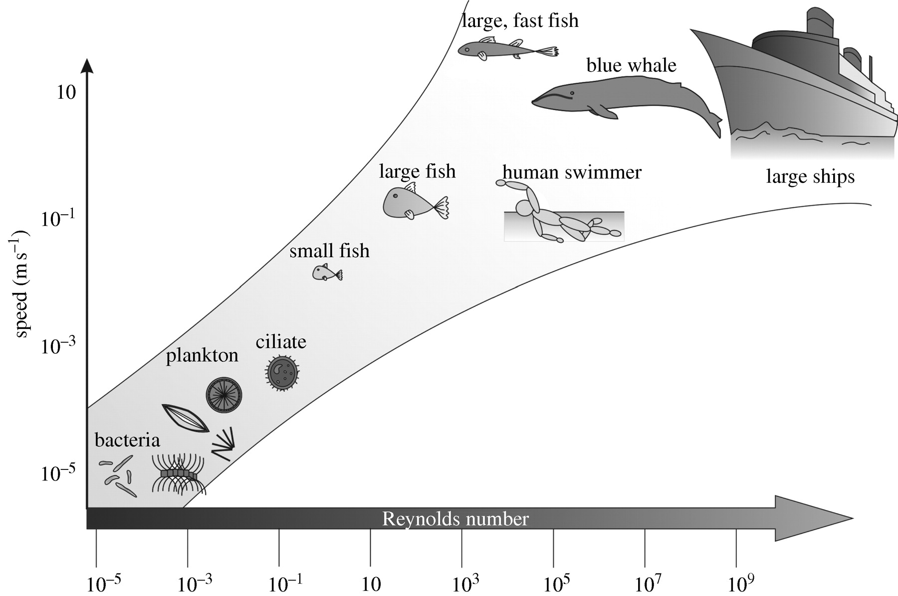
Hydrodynamic interactions—Reynolds number variation for biological systems with respect to speed
La vie en nano
Designing biomimetic antifouling surfaces BY MARIA SALTA1, JULIAN A. WHARTON1,*, PAUL STOODLEY1, SIMON P. DENNINGTON1, LIAM R. GOODES1, STÉPHANE WERWINSKI1, UGAR MART1, ROBERT J. K. WOOD1 AND KEITH R. STOKES1Phil. Trans. R. Soc. A (2010) 368, 4729–4754

Slide 25
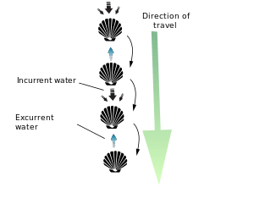
Las consecuencias de ser nadadores microscópicos (teorema de la vieira)
Los flujos laminares son reversibles. Al invertir un movimiento rotacional por ejemplo, las particulas inmersas en un flujo laminar regresan a su posicion original retrocediendo por el camino inverso. Esta reversibilidad afecta la manera en que un animal se impulsa a traves del fluido. En medios donde gobierna la viscosidad por sobre la inercia, el impulso que consiguen nadadores que ejecutan movimientos hacia un lado de una articulación (por ejemplo peces que se desplazan oscilando su cola), es cancelado por el movimiento reverso cuando la cola retorna a su posición original.
2
El “teorema de la vieira” (scallop theorem) dice que en un medio de bajo NR, ningun nadador puede autopropulsarse eficientemente mediante movimientos ejecutados con una unica articulación (como la viera, que se mueve propulsada por el flujo de agua movida por el movimiento ritmico de sus valvas, o los peces),
1
2
1
http://dict.eudic.net/dicts/search/Scallop.html
http://www.seas.harvard.edu/brenner/taylor/handouts/lowreynolds/node3.html

Slide 26

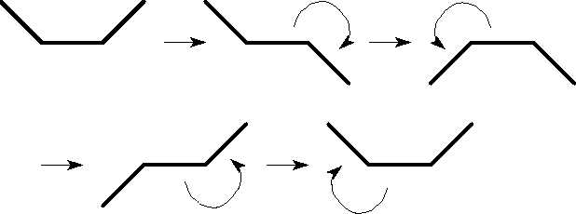
Las consecuencias de ser nadadores microscópicos (teorema de la vieira)
Este problema es sufrido por todo nanador microscopico, para quien el agua tiene un NR muy bajo. Si el nadador microscópico posee en cambio 2 articulaciones :
articulación
articulación
se lograría un movimiento no reversible en el tiempo, como se ilustra en el siguiente diagrama, donde las flechas denotan el movimiento hacia adelante en el tiempo:
1
2
3
4
Este patrón no es reversible en el tiempo (2 no es la inversa de 1: no se cancelan) y origina un movimiento neto hacia adelante. .
http://www.seas.harvard.edu/brenner/taylor/handouts/lowreynolds/node3.html

Slide 27

Las consecuencias de ser nadadores microscópicos (teorema de la vieira)
Las bacterias y otros organismos unicelulares han desarrollado estrategias de natación que no dependen de la inercia. Para ello emplean flagelos helicales rotatorios, flagelos o colas que ejecutan movimientos de flexion, y cilias flexibles que cubren la superficie de grandes celulas; llevan a cabo movimientos de remo y ondulando en coordinación. La auto propulsion es conseguida por cambios periodicos de forma (swimming strokes). Una excepción la constituyen los flagelos rotatorios de bacterias, cuyos movimiento depende motor submicronico rotatorio capaz de girar el eje de la helice sin alterar entre direccion horaria y antihoraria.
http://www.seas.harvard.edu/brenner/taylor/handouts/lowreynolds/node3.html

Slide 28
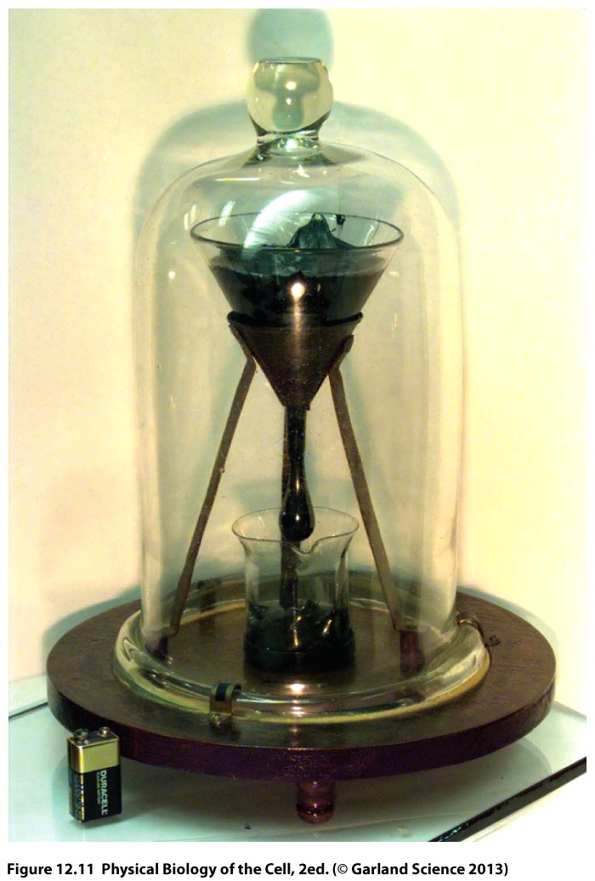
Ante la aplicación de una fuerza, los fluidos se desplazan (“fluyen”); los solidos en cambio no lo hacen o lo hacen muy lentamente
Los asfaltos/resinas son sólidos poliméricos viscoelasticos.
La viscosidad del asfalto/resina es ∼ 2 x 10⁶ la de la miel, o 2 x 10¹⁰ la del agua.
La velocidad de caida de la gota depende de la composición exacta del asfalto/resina, y de su entorno (temperatura, vibraciones)
The Pitch Drop Experiment: Uno de los experimentos mas largos del mundo comenzo en 1927: debia mostrar como una resina, aunque aparentemente solida, actuará como un fluido fluyendo lentamente a traves un embudo de vidrio.
John Mainstone, director del Departamento de Fisica en la Universidad de Queensland, fue su custodio por 52 años. En 90 años solo cayeron 8 gotas
Para una Escherichia coli, las propiedades viscosas del agua son identicas a las que a un pez ofrece este asfalto!!
La vie en nano

Slide 29
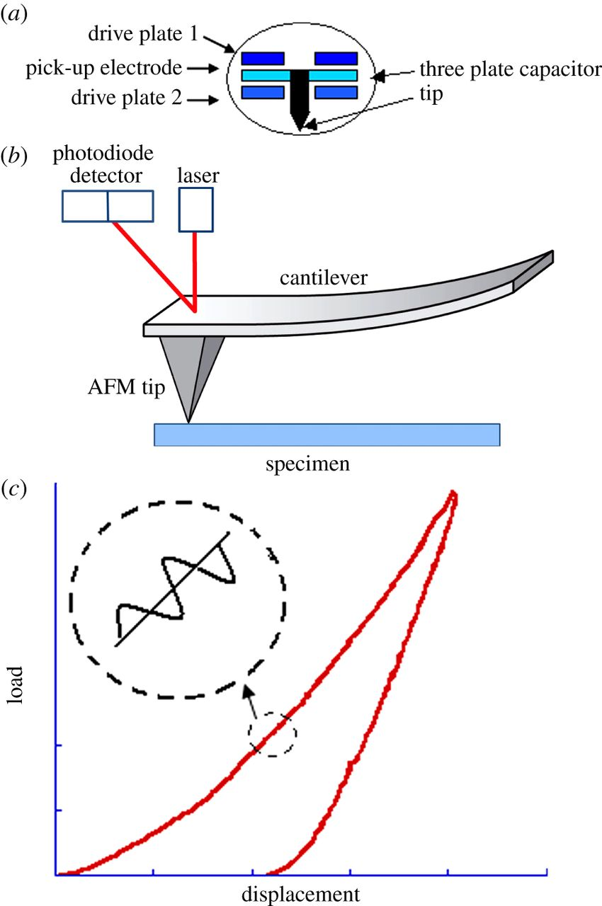
Nano-biomechanics can be considered an offspring of biomechanics in the sense that it deals with the effect of force on biomolecules and biostructures of the order of nanometer and nanonewton ranges.
The principle of mechanics is the same in biomechanics and nano-biomechanics, but the methods to measure a small force and its effect on biosystems are different from those used in macroscopic biomechanics.
Classical mechanics deals mainly with materials that are homogeneous in composition and large in their scale compared with the size of a test probe.
Recent development of various physical methods to measure small forces and small displacements has encouraged researchers interested in biomacromolecules and cellular structures to elucidate the relationship between the magnitude of applied force versus that of the deformation occurring in their samples (stress–strain relationship) at the molecular level. By establishing such relations experimentally and by applying theoretical predictions, we can extract mechanical parameters inherent to the material properties of the sample.
Thanks to the technological and theoretical advancement in nanoscience and nanotechnology fields, it is now possible to push and/or pull a single molecule of proteins to obtain the force to unfold it from a compact globule to a linearly extended string.
The resulting response curves tell us about the rigidity and tensile strength of the intramolecular structure.
A similar experiment is now also possible on a single strand of DNA, the very genetic material. The method has been applied to elucidate the mechanistic principle of folding DNA of a total length approximately 1m into the cellular nucleus of an approximate diameter of a few micrometers.

Slide 30
La fuerza que actúa sobre un objeto esférico de radio r en un flujo laminar esta dada por the Stokes’ law mentioned below, where f,η, and v are, respectively, frictional coefficient, fluid viscosity, and velocity of the sphere, of which 2/3 comes from viscosity of water and 1/3 from the pressure effect of water.
For a bacterium of approximate diameter of 1 μm and swimming in water at a speed of 1 μm per second, the force is approximately 0.02 pN, which is quite small compared with the force generated by the flagella system of the bacterium.
In a micro- to nanometer-scale world, viscous force predominates over the inertial resistance or the eddy current drag, and the magnitude of the viscous dragging can be calculated according to the Stokes’ law.
The frictional coefficient must be changed depending on the shape of the moving body. Frictional coefficient for nonspherical bodies can be approximated by the method developed by Garcia or by fitting to analytical expressions for prolate or oblate ellipsoids . An approximate value of the frictional coefficient of an object of any shape can be obtained by modeling the shape of the object by an assembly of spheres of radius Ri with the center-to-center distance rij from another sphere of radius Rj by using the following equation. The method was applied by Ikai to obtain the frictional coefficient of complex proteins .

Slide 31
Frictional coefficients
The frictional coefficients of a cylinder of length L and radius r in laminar flow are given in Table 1.1. Here, the subscripts denote whether the flow and the cylinder are parallel or perpendicular to each other, respectively .
η,L,r,b, and a are, the viscosity coefficient of the fluid, the length and the cross-sectional radius of cylinders, and the long and short axes of ellipsoidal bodies, respectively. For frictional coefficients for a cylinder near a plane surface,

Slide 33
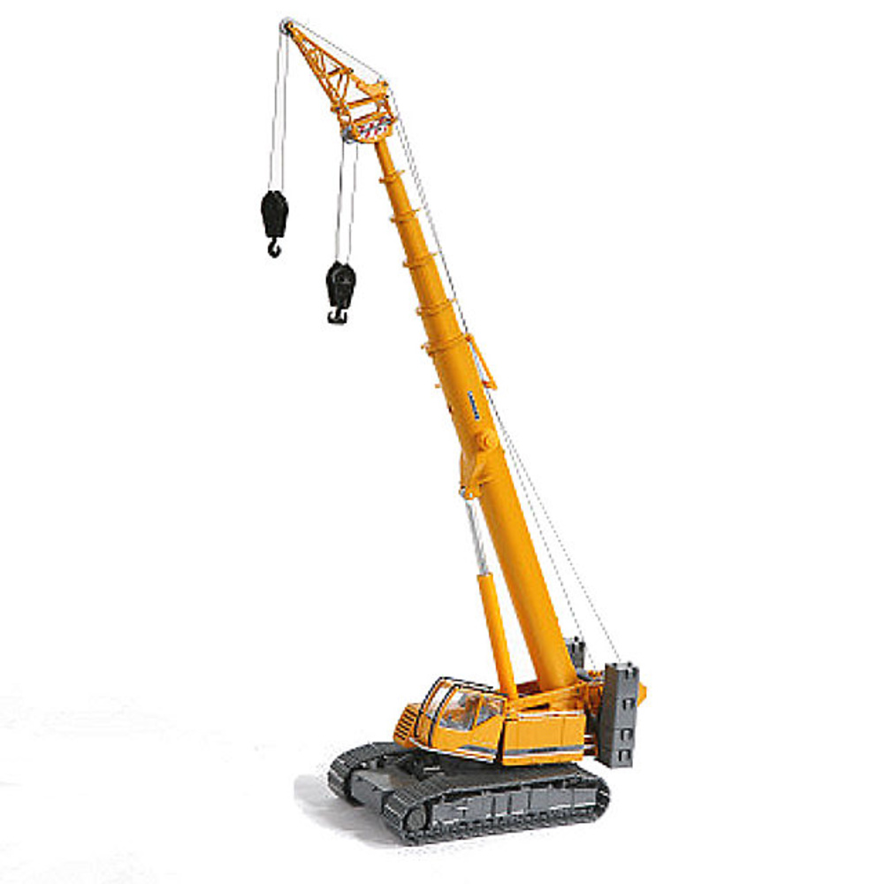
Molecular Basis for Structural Design
The basic principle of the structural design of biological systems is building everything bottom up ‘from molecules’, meaning that macroscopic components of the body are all built directly from molecules and molecular interactions. Since there are no construction workers around, our body is built on the principle of self-association/ self-assembly of constituent molecules. In contrast, the crane [grua] at the construction site, as an example, is made of a relatively small number of macroscopic members of explicit designs, each member being rigid and unbending. They are joined by a team of assembly men or robots using a relatively small number of flexible joints that will maintain the freedom of motion of each member, and its motion is controlled by the force delivered from a centrally located electric motor(s) through a network of wires.
The human arm execute a similar task as a crane in a smaller scale, but the motion of an arm is controlled directly by a collection of myocytes (muscle cells) and the force is generated directly from the molecular motion of protein filaments in the cell. Thus, the biological systems are built on the dynamic interactions of a large number of molecules, mainly proteins. Proteins are linear polymers of 20 kinds of amino acids and are tightly folded into specific 3D conformations that are programmed most appropriately for their unique functions.

Slide 34
Molecular Basis for Structural Design
On the individual basis, proteins function as enzymes, antibodies, receptors, channels, inhibitors, and hormones, and in organized forms, they function as microtubules, muscle filaments, tendons, bones, teeth, hair, silk fibers, to name a few. Thousands of enzymes are known, for example, each catalyzing a different reaction in a concerted way, so that thousands of biochemical reactions proceed in a controlled fashion to keep the host organism happily alive.
As stated above, an enzyme has the capacity to bind only one kind of molecule, called substrate, out of millions of others to its active site and carry out a necessary transformation to the molecule. Binding of a substrate to the active site, thus, is the first step of the enzyme catalysis. Such binding is basically a mechanical process in the sense that the substrate is attracted and being directed to the active site through mechanically guided processes. And when finally the substrate is closing in on to the enzyme’s active site, the 3D conformation of the enzyme is altered to accommodate the substrate into its active site, forcing the former to change into a different, somewhat distorted conformation from its most stable state, especially around the bond(s) to be broken. The distorted conformation is similar to the activated state of the substrate in the reaction pathway leading to the product.The bound substrate thus sits ‘activated’ in the active site of the enzyme. This activation is done without raising the temperature but at the expense of the energy of binding to the active site.
The active site of the enzyme has strategically located functional side chains of amino acid residues to hold the substrate in a geometry resembling its activated state, thus facilitating the conversion from the reactant to the product under ambient conditions. In the activated state, the substrate is supposed to be in a mechanically strained conformation and the enzyme must be rigid enough to sustain the strain for an extended period in which the reaction proceeds with a higher probability.

Slide 35
ForceS in Biology
Binding, to be precise, specific binding is an important central issue in biochemistry. Many proteins work in association with other molecules, endlessly repeating mutual binding and unbinding processes. When binding molecules are small, they are called ligands and the protein is called receptor, but very often ligands are specific parts of macromolecules such as DNA, proteins, and polysaccharides. In such cases, the macromolecules are also called ligands.
Antibodies are a good example of binding proteins without catalytic functions. They constitute a closely related family of proteins with a common 3D structure but each having a different affinity to a selected ligand molecule called an antigen.
Antigen binding to an antibody is similar to substrate binding to an enzyme, but antibodies neither activate their ligands nor catalyze their transformation to other molecules. An attempt to modify the arrangement of amino acid residues in the binding site of an antibody so that it would activate the bound ligand was successfully performed by Lerner and the antibody-turned-enzyme is called catalytic antibody or ‘abzyme’.
Referring back to an antibody, it rather retains antigen in the stable ground state and forms 3D network gels through its divalent and sometimes multivalent binding capacity. Formation of such a 3D network gel helps clearance of foreign antigens from the host by activating the immune clearance system involving scavenger cells such as macrophages. Antigen binding and the formation of a 3D network by antibody–antigen complexes are largely governed by thermodynamics of the system, but the mechanical stability of the system is also an important factor for the survival of the network in blood.
Another prominent group of binding proteins is receptor proteins, many of which are anchored to the cell membrane through association of their highly hydrophobic, membrane-traversing segments with the hydrocarbon layer of the phospholipid membrane.
These proteins are called intrinsic membrane proteins and usually have extracellular and intracellular segments on the opposite ends of the membrane-traversing segment(s). Ligand binding takes place at the binding site on the extracellular segment in most of the cases but occasionally on the intracellular side as well.
Ligands bind to a particular receptor to transmit physiological information from other parts of the body, which require particular types of cells to change their biochemical activities in accordance with a new metabolic status of the body.
Binding of ligands to the extracellular binding site of the receptor should, therefore, be transmitted to the intracellular metabolic system by way of a conformational change or the aggregation status of receptors.

Slide 36
Soft versus Hard Materials
Our body is made from a huge array of weak interactions between and among tiny constituents called biomolecules.
The soft and flexible nature of our body enables us to assume millions of subtly different facial features and bodily postures, which are still very difficult to reproduce in robots. Robots are made of metals, plastics, and amorphous materials, all of which are bulk solid materials. The subtleness of the bodily movement of robots is defined by the size of constituent components and the strength of the connecting bonds between them.
Since the components of the robotic body are of the order of cm and the strength of the connection between them is of the order of a few newtons; their behavior has a ‘centimeter-order’ smoothness but not a ‘micrometer-order’ one, which makes human bodily movements look almost seamless, especially when young and trained, as displayed by top players in Olympic games
Thus, we understand that our body is not made of solid arms and wires as we see in the design of cranes at a construction site.
Muscle is made of billions of billions of protein molecules called myosin and actin, which are bundled into very thin, but still molecular size fibers.
The force generating interactions between myosin and actin have been shown to act at a magnitude between zero and a few piconewtons, that is 10⁻¹² N. A force of 1N is the weight of 100 ml of water placed on our hand. A piconewton is one trillionth of 1N, meaning that we need at least 10¹² pairs of myosin versus actin interactions to lift 100 ml of water. By changing the number of myosin versus actin interaction pairs, we can control the force almost continuously.
Whereas the soft parts of biological structures are usually made of proteins, lipids, and carbohydrates, the hard parts such as bones, shells, or scales are mainly composites of inorganic and organic materials. Mammalian bones are made of calcium phosphate complexed with the protein called collagen, and shells of oysters and other shellfish are made of calcium carbonate complexed with the protein called conchiorin. The crustacean shells are composed of the rigid polysaccharide called chitin, complexed with calcium ions. The building principles of such biological hard materials are similar to bulk materials such as concrete used in the construction of man-made buildings.

Slide 37
Soft versus Hard Materials
The most prominent characteristics of living organisms is found, however, in the soft parts such as muscle, heart, liver, skin, and brain. Since the most conspicuous ingredients of the soft parts of the body are proteins, let us take a brief look at them from the viewpoint of materials science. Protein is most familiar to us as meat. Meat is the soft part of the body of animals, mammals among others, and has a texture very similar to that of our body.
Proteins are encased inside the cell, which is basically a spherical bag made of phospholipid bilayer membranes.
The phospholipid bilayer is approximately 5 nm in thickness and is permeable to water and many nonpolar molecules but impermeable to ionized molecules. The small bag made of phospholipid bilayers has the ability of generating a heterogeneous environment in an otherwise homogeneous medium. Within the encasement of phospholipid bilayers, the most abundant macromolecules are proteins of thousands of different kinds and functions. The characteristics of each protein is determined by the number of amino acid residues covalently linked to one polymeric molecule and by
the order of their alignment from one end to the other end of the molecule. A particular alignment of the amino acid residues is called the amino acid sequence, and it generates a special biological function(s). Thus, a polymer having a particular sequence is recognized as a new protein and is given a special name. All amino acids have an amino group and a carboxy group attached to the central α-carbon atom.
The remaining valencies of the α-carbon atom are occupied by a hydrogen atom and the ‘side chain’ group. Those amino acids that have the amino group on α-carbon atom are called α-amino acids. The chiral nature of the α-carbon is fixed in L-form. The difference in the side-chain structure classifies amino acids into 20 groups, but the rest of the structure around the central α-carbon atom is common to all the 20 kinds. Theoretically, the list of α-amino acids is endless, but the living organisms utilize only 20 to 22 kinds of them to build proteins in the cellular machinery.
Thus, it is a common knowledge today that a protein molecule spontaneously takes on a native conformation, provided it is given the freedom to do so. Such freedom is sometimes or often compromised inside the cell due to the crowded condition therein. In such cases, a certain class of proteins generically called chaperones come in to rescue, providing coveted freedom for each individual polypeptide to fold in a segregated condition . Basically chaperones catch an unfolded polypeptide and sequester it inside of its own cavity, and keep the latter for a few seconds until it successfully folds into a correct native conformation

Slide 38
Biological and Biomimetic Structural Materials
Humans show strong desire to mimic subtle and efficient biological functions by using synthetic materials. One prominent reason for this desire is to improve the fragile nature of biological functions to more durable ones so that they can be used in a convenient manner. There is an effort to create soft materials such as proteins and protein-based structures from synthetic polymers and their composites with inorganic materials and use them as either temporary or permanent replacements for injured or damaged tissues in a patient. To choose appropriate synthetic materials as best fit for the human body, i.e., the one with the best biocompatibility, we have to know the physical properties of the original tissues in addition to their chemical and biochemical properties. It is a common practice to measure mechanical constants of the candidate materials considered relevant for the replacement of hard tissues such as bones and teeth.
It is also important to measure or estimate the mechanical constants of muscles and blood vessels that would surround the replacements. Improvements of the surface properties of biomimetic structures are one of the most intensely explored field together with the recent advancement in the production of biodegradable polymers and ceramics.
Wear and Tear [desgaste por uso] of Biological Structures
Can proteins and other biological structures repeat catalytic or binding activities endlessly without wear and tear? When a stress is applied to a macroscopic object which is perfectly elastic, its shape changes and strain energy [energia de deformacion] accumulates inside, but when the stress is removed, the shape returns to the original one and the strain energy returns to zero. In practical cases, certain rearrangements of the atomic-level structure take place while the material is in a strained state, and the eventual removal of stress does not let all the atoms go back to the original positions; thus the material does not regain its original shape. Such is the case of partially plastic materials. If this process is to be repeated tens of thousands of times, continuous rearrangements of atoms and bond breaking will eventually form a small cavity or a crack within the material, which will lead to the fracture of the material

Slide 39


Slide 40
Fatiga de los materiales
A general theory and experimental observations on the fatigue of materials is summarized in Suresh, S. (1998) ‘Fatigue of Materials’ (Cambridge Solid State Science Series) (2nd ed.). Cambridge University Press. Cambridge, UK.. Propagation of preexisting cracks was conceived as an important factor of mechanical breakdown of materials by Griffith in the 1920s. He conjectured from the material constants of materials with a microscopic crack that the tensile strength of materials would be much less than expected because an externally applied force (or in terms of stress that is defined as force per unit cross-sectional area) tends to concentrate around the edge of the crack and a brittle [fragil] fracture of material takes place as a result of crack propagation
Fatigue is a special kind of fracture that occurs after application of external force for an extended duration of time and is most often observed in the fracture of metallic objects.
The critical stress σc required for crack propagation in a brittle material is given by
Crack propagation due to an applied stress (s). Curvature becomes zero at
the edge of the crack
Crack propagation in an imperfect 2D material. A preexisting
crack in (a) is deformed by the application of longitudinal stress
so that the curvature at both ends of the crack becomes zero. Stress
concentration takes place at the two edges resulting in the propagation
of the crack along horizontal directions as in (b).
where Y is Young’s modulus, γs specific surface energy, and a half of the length of an internal crack.

Slide 41
Biological nanostructures are surprisingly durable against wear and tear.
A good example is the red blood cell which circulates in our body approximately 200,000 times during its life-time of approximately 120 days
During its circulation through blood vessels, it must endure tortuous journeys of passing through capillaries only half as
wide as its own diameter of 8 μm. Inside the capillaries it changes its form from the usual biconcave one to a bullet type. After red blood cells repeat this shape change for hundreds of thousands of times, they retain almost all their biological activities, but they are constantly replaced with new ones with an average half-life of 120 days.
If the surface of an object is constantly in the abrasive contact with another surface, a certain fraction of surface atoms will be constantly torn away, with the process leading to the wearing of the surface. Our bodily surface is covered with skin, i.e., the epithelial cells, which are constantly being renewed from the inside after shedding of the old ones. This constant replacement of old bodily components with the newly formed ones is the basic principle of coping with wear and tear of constituent materials in biological world. You can see it in plant life as well when trees shed leaves after using them from spring to autumn for photosynthesis and respiration and wait for the new ones to bud in spring,
renewing their synthetic life.
A question arises then, do biomolecules, or more in general terms, do molecules wear and tear? Under the influence
of light, especially that of UV light, x-rays, or strong electric field, molecules are decomposed, but under mechanical strain, molecules are not broken down easily. In conclusion, the structural changes of biological molecules and structures responsible to their functions are basically repeatable millions and billions times and there seems to be little wear and tear of them

Slide 42
Elastic and Plastic Deformation of Materials
Los materiales experimentan deformaciones toda vez que se aplican tensiones, compresiones o fuerzas de cizalla
fuerzas de tension elongan
fuerzas de compresion acortan
fuerzas de cizalla [shear force] distorsionan
Materiales elasticos: Upon removal of the applied force, the shape of an elastic sample returns to the original one, and, if not, the sample is partially or totally plastic.
In many cases, samples show an elastic deformation while the applied force is small and as the force becomes greater, contribution of plastic deformation gradually increases.
During an elastic deformation, the covalent and noncovalent bonds that hold the atoms in the sample body are not broken but displaced from their equilibrium distance, i.e., deformed due to the application of an external force, but on removal of the force all the deformed bonds return to their equilibrium positions, recovering the original shape of the object.
The initial linear region is called Hookean regime where the strain is reversible, which is followed by a sudden breakdown of the linear relationship and a large deformation with a small increase of stress.
The breakdown process of a sample under application of
tensile stress, σ, on the ordinate, and the corresponding strain, on the abscissa.
Materiales plasticos: If the bonds that keep the sample in a fixed shape are weak or if the applied force is large, consequently under a large deformation regime, some of the covalent or noncovalent bonds are broken and therefore cannot restore the original equilibrium positions. As a result, the shape of the sample material is permanently changed, and such a deformation is termed plastic deformation. Unless all the bonds are broken, the sample shape is partially restored.
The deformation of an ordinary material sample often proceeds as shown. The range of strain of the elastic deformation regime is small for materials such as steel or silicon but large for rubber or plastics.
point of maximum stress
final breakdown
Deformation and ultimate breakdown of mechanical members generally proceed along the line in this figure.
The region of nonlinear extension of the material is possible with a supply of material to the extending region from other regions and is made possible through the mechanism called ‘necking.’

Slide 43
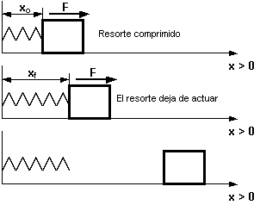
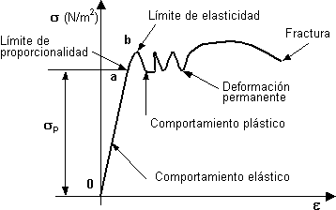
Resortes: Los resortes reales se comportan según la siguiente ecuación, conocida como la Ley de Hooke: las tensiones son proporcionales a las elongaciones. Los materiales que responden a esta ley son perfectamente elásticos
F = k.Δx
k: magnitud de la fuerza por unidad de elongación, que depende de cada resorte [N/m].
Δx = x_{f} - x_{o} [m]
Tensión o esfuerzo: es la relación entre una carga y la superficie sobre la que actúa. Se considera como tal a la reacción que opone el material de un cuerpo frente a una solicitación externa (de tensión, compresión, cortante) que tiende a producir un cambio en su tamaño o forma.
σ = F/A ⇒ σ = ε .E
E: módulo de elasticidad del material. [N/m²; kg/cm²]
A: sección del material [m²; cm²]
Elongaciones: un cuerpo sometido a la acción de fuerzas externas sufre alargamientos o acortamientos en una dirección dada que reciben el nombre de deformaciones.
Deformación específica:
ε = Δl/l Δl: elongación
l: longitud origina
acortamiento ε < 0
alargamiento ε > 0
Dentro del límite de proporcionalidad (σ _{p}), el módulo de elasticidad de un material dado es constante, dependiendo solo de la naturaleza del material.

Slide 44
De 0 hasta a,se llama recta de Hooke. Sin embargo hasta b inclusive, cuando descargamos la pieza recupera su longitud original (entre 0 y b, el material es elástico).
Modulo de Young: es la constancia de la relación entre tensiones y deformación específica.
E = σ / ε = constante
Esta relación es la expresión analítica de la ley de Hooke.
Elasticidad: una deformación se llama elástica cuando desaparece completamente (recuperable) una vez que cesa la causa que la produjo.
Plasticidad: una deformación plástica es aquella que no desaparece (irreversible) con la anulación de la causa. La plasticidad de los materiales esta dada por su capacidad de poder deformarse sin por ello sufrir fractura. Un material es tanto más dúctil cuanto más extendido es su diagrama σ - ε en el sentido del eje ε.
A medida que aumenta la resistencia de los materiales disminuye la deformación específica y por lo tanto su ductilidad. Se dice entonces que el material va ganando en fragilidad.
La maleabilidad como propiedad de los materiales, específicamente metálicos, constituye en realidad una fase de la ductilidad.
Tenacidad: es la capacidad de un material para absorber simultáneamente esfuerzos y deformaciones de consideración sin llegar a la fractura.
Rigidez: es la capacidad de resistir una deformación elástica por efecto de una tensión.
Fluencia: en los materiales tenaces el período plástico comienza teóricamente a partir del punto a(límite de proporcionalidad), que constituye el final del período de proporcionalidad (recta de Hooke). En realidad,el material suele ser elástico, un poco más allá de dicho punto, hasta el punto b (límite de elasticidad).

Slide 45
Stress and Strain Relationship: [Relación tensión-deformación: modulo de Young]
Normalización de respuesta de materiales frente a la aplicación de fuerza: Y=modulo de Young= The proportionality constant of the stress–strain relationship in the elastic regime of deformation
For a relatively small strain, the stress follows the Hooke’s law and is proportional to the strain
In linear mechanics, they are linearly related as σ = Y Ƹ , where Y is a constant called Young’s modulus.
σ =F/A=Y (ΔL/L0)
Elongation of a rectangular member under a tensile force along the axial direction. The relative elongation, ΔL/L0, is defined as strain (Ƹ) [deformacion] and the force per unit cross-sectional area, F/A, is defined as stress (σ).

Slide 46
When the strain is small, the above relationship applies to both a positive and a negative strain; therefore, elongation (ε > 0) and compression (ε < 0) are symmetric.
Stress has the dimension of N (newton) per m2, whereas strain is dimensionless
. Therefore, Y has the dimension of N/m2, which is given a special name, pascal, abbreviated as Pa.
Rigid material such as steel, Y is as large as 1–3×10¹¹ Pa = 100–300 GPa,
Soft materials such as plastics and wood, Y is in a smaller range in the order of 10⁹ = 1 GPa and for rubber it is even down to 10⁶ = 1MPa.
Roughly, man-made objects have Young’s modulus between 1 and 1000 GPa, whereas the bodily materials of living organisms have young’s modulus within 1/1000 of such values, i.e., between1 and 1000 MPa (see Table 2.1).
The plastic nature of the materials comes from their liquid-like property. If the material is totally plastic, the sample deformation never stops and the sample is liquid-like. The resistance of the sample against the applied stress is only temporary due to the internal viscosity of the liquid.

Slide 47
Mechanical Breakdown of Materials
When a tensile force is continuously applied to a sample body, initially elongates in proportion to the magnitude of the force (Hookean regime), and after reaching a peak, the force is reduced, with a further elongation of the sample. In this plastic elongation regime, the sample suffers a deformation called ‘necking’, where a sudden thinning of the sample is observed. The peak force observed before the start of necking is called yield force.
After yielding to the tensile force, the sample is further elongated with a small increase of force. After sustaining a maximum force (tensile strength), the sample is finally torn into smaller parts.
.
The Hookean regime for hard materials is very narrow on the abscissa, and a sharp and linear increase of stress results in a straight line with a large slope corresponding to a high value of Young’s modulus. Whereas soft and elastic materials such as rubber show a wide range of Hookean regime. Necking is a prominent feature in plastics and metals. The breaking behavior of biological materials at the molecular level is not well known yet and will be the subject of nano-biomechanics in the near future.
Limite de elasticidad

Slide 48
Viscoelasticity
Materials that exhibit a pronounced contribution of fluid-like viscosity in addition to elasticity are called viscoelastic materials.
Their mechanical properties depend on the time scale of force application. If a force is applied over a short duration of time, their behavior is almost solid-like, but if the force is applied slowly, they behave like fluids.

