Slide 1
Clase 3. Introducción a la Nanotecnología. Propiedades de la materia en la nano-escala. Resonancia Superficial Plasmones
Detection by Surface Plasmon Resonance (SPR)
- Surface plasmon resonance (SPR, Pharmacia, end of the 1980s) is a detection technique which grew in the middle of the 1990s
- standard method for studying molecular interactions, especially protein interactions, on surfaces.
- it provides a way of detecting the presence of molecules in the immediate vicinity of a surface (within 100–300nm) without the need to label the molecules.
- Reactions can be monitored in real time, so reaction kinetics can be recorded and one can determine whether two families of molecules react together or not, as well as the binding force, association and disassociation constants, and after calibration, the concentrations of different molecules.
ellipsometry {does not permit real-time measurements]
evanescent wave fluorescence spectroscopy (with excitation by evanescent waves)
fluorescence recovery after photobleaching (FRAP) .
Técnicas pre-existentes SIN ESTANDARIZAR
Nanoscience. Nanobiotechnology and NanobiologyP. Boisseau • P. Houdy • M. Lahmani (Eds.) c Springer-Verlag Berlin Heidelberg 2010Chapter 7 Optical Tools E. Roncali, B. Tavitian, I.e Texier, P. Pelti´e, F. Perraut, J. Boutet, L. Cognet, B. Lounis, D. Marguet, O. Thoumine, M. Tramier

Slide 2
Clase 3. Introducción a la Nanotecnología. Propiedades de la materia en la nano-escala. Resonancia Superficial Plasmones
By proposing an instrument that could handle liquids in a fully automated way, control the temperature, and analyse results by means of dedicated software, together with a microfluidic system, viz., the SensorChip (perhaps the first commercial microsystem for biology) and anchoring procedures, Pharmacia provided equipment that biological research teams could use to focus on their own field of research without having to develop specific instrumentation themselves. Biacore products have gradually become standard laboratory equipment on a par with the spectrophotometer, and the SPR technique is now the reference for studying molecule/molecule interactions. Later, Biacore became an independent company of the Pharmacia group and was recently bought by General Electric. It is interesting to analyse these developments. Indeed, each of the various detection techniques was intrinsically as powerful as any of the others, but it was the development of tools, e.g., by Biacore, which made these tests routine that allowed one technique to prevail over the others

Slide 3
Clase 3. Introducción a la Nanotecnología. Propiedades de la materia en la nano-escala. Resonancia Superficial Plasmones
Lo que queremos estudiar (proteínas, etc ) está de este lado
• When monochromatic, polarised light hits an interface of two transparent media, such as a glass prism and a buffer solution, from the side of the media with the highest refractive index (glass prism), the light is partly reflected and partly refracted towards the plane of the interface.
• However, above a certain incidence angle, all of the light is reflected and none of it is refracted. This phenomenon is called Total Internal Reflection (TIR).
• In SPR, the glass prism is coated with a Au film. In conducting metals, such as Au, the free conduction electrons form periodic oscillations, called plasma waves. Like every periodic electromagnetic wave, this can also be described in a particle fashion. Like photons and phonons are the particle names for light and sound waves, respectively, a plasmon is the particle name for the plasma wave.
buffer
prisma

Slide 4
Clase 3. Introducción a la Nanotecnología. Propiedades de la materia en la nano-escala. Resonancia Superficial Plasmones
• Surface plasmons are those plasmons that are confined to the surface of the metal. They occur at the interface of the Au surface and the buffer. These plasmons create an electric field that extends about 100 nm both into the buffer solution and into the Au film and glass prism. This electrical field is called an evanescent wave, because it decays exponentially with distance.
• When the incident light beam has the correct incidence angle within TIR, surface plasmon resonance occurs. At this so-called ‘resonance angle’, θ, the photons in the light beam have a momentum (vector with magnitude and direction) equal to the momentum of the surface plasmons, and the photons are converted into plasmons. In other words, optical energy is coupled into the Au surface. As a result, reflection is decreased at this resonance angle.
At a certain angle of incidence, a portion of the light energy couples through the metal coating with the electrons in the metal surface layer, which then move due to excitation. The electron movements are now called plasmon, and they propagate parallel to the metal surface
CHAPTER 1 Introduction to Surface Plasmon Resonance ANNA J. TUDOSa AND RICHARD B.M. SCHASFOORTb
Surface Plasmon Resonance: A Versatile Technique for Biosensor Applications. Hoang Hiep Nguyen 1,2,†, Jeho Park 1,2,†, Sebyung Kang 3,* and Moonil Kim 1,2,4 Sensors 2015, 15, 10481-10510; doi:10.3390/s150510481

Slide 5
Clase 3. Introducción a la Nanotecnología. Propiedades de la materia en la nano-escala. Resonancia Superficial Plasmones
SPR is an optical method using measurements of the reflectance of a thin metal film (between ten and a hundred nanometers thick), deposited on a glass surface. Gold or silver can be used but gold is preferred because it is more stable under general conditions of use. If the metal surface is illuminated through a glass substrate and if the reflectance is measured along the angles of incidence, it is observed that, for a very narrow range of angles, the reflectance is weak, even zero. The photons of the incident light excite free electrons in the lattice structure of the metal and these electrons begin to resonate. There is therefore a transfer of light energy to maintain the electron vibrations. This vibration produces the so-called plasmon wave, whose wave vector lies parallel to the surface. It can interact over several tens of nanometers of the probed medium in an analogous way to an optical evanescent wave, whose properties and characteristics it shares. If the refractive index of the probed medium changes in the immediate vicinity of the surface, the angle of incidence of the light for which resonance occurs will also change, and this can be exploited to detect the adsorption of molecules
In a commercial SPR biosensor configuration, incident light is employed by using a high-reflective index glass prism in the Kretschmann geometry of the attenuated total reflection (ATR) method
Detection is thus accomplished by measuring the changes in the reflected light obtained on a detector. In addition, the amount of surface concentration can be quantified by monitoring the reflected light intensity or tracking the resonance angle shifts. Typically, an SPR biosensor has a detection limit on the order of 10 pg/mL.

Slide 6
Clase 3. Introducción a la Nanotecnología. Propiedades de la materia en la nano-escala. Resonancia Superficial Plasmones
(B) spectrum of reflected light before and after refractive index change
In SPR biosensors, probe molecules are firstly immobilized on to the sensor surface. When the solution of target molecules is flown into contact with the surface, a probe-target binding via affinity interaction occurs, which consequently induces an increase in the refractive index at the SPR sensor surface (Figure 1D).
(C) analyte-biorecognition elements binding on SPR sensor surface
(D) refractive index changes caused by the molecular interactions in the reaction medium.
Surface Plasmon Resonance: A Versatile Technique for Biosensor Applications. Hoang Hiep Nguyen 1,2,†, Jeho Park 1,2,†, Sebyung Kang 3,* and Moonil Kim 1,2,4 Sensors 2015, 15, 10481-10510; doi:10.3390/s150510481

Slide 7
Clase 3. Introducción a la Nanotecnología. Propiedades de la materia en la nano-escala. Resonancia Superficial Plasmones
SPR sensors investigate only a very limited vicinity or fixed volume at the metal surface. The penetration depth of the electromagnetic field (so-called evanescent field) at which a signal is observed typically does not exceed a few hundred nanometers, decaying exponentially with the distance from the metal layer at the sensor surface. The penetration depth of the evanescent field is a function of the wavelength of the incident light
SPR sensors lack intrinsic selectivity: all refractive index changes in the evanescent field will be reflected in a change of the signal. These changes can be due to refractive index difference of the medium, e.g. a change in the buffer composition or concentration; also, adsorption of material on the sensor surface can cause refractive index changes. The amount of adsorbed species can be determined after injection of the original baseline buffer. To permit selective detection at an SPR sensor, its surface needs to be modified with ligands suited for selective capturing of the target compounds but which are not prone to adsorbing any other components present in the sample or buffer media.
A sensorgram: the angle at which the dip is observed vs. time. First, no change occurs at the sensor and a baseline is measured with the dip at SPR angle (A). After injection of the sample (arrow) biomolecules will adsorb on the surface resulting in a change in refractive index and a shift of the SPR angle to position B. The adsorption–desorption process can be followed in real time and the amount of adsorbed species can be determined.

Slide 8
Clase 3. Introducción a la Nanotecnología. Propiedades de la materia en la nano-escala. Resonancia Superficial Plasmones
On injecting the solution containing the analytes (2), they are captured on the surface. Also other components of the sample might adhere to the sensor surface; without a suitable selection of the
ligand, this adherence will be non-specific, and thus easy to break. At this step, adsorption kinetics of the analyte molecule can be determined in a real-time measurement.
Next, buffer is injected on to the sensor and the non-specifically bound components are flushed off (3). As indicated in the figure, the accumulated mass can be obtained from the SPR response (ΔR). Also in this step, dissociation of the analyte starts, enabling the kinetics of the dissociation process to be studied. Finally, a regeneration solution is injected, which breaks the specific binding between analyte and ligand (4). If properly anchored to the sensor surface, the ligands remain on the sensor, whereas the target analytes are quantitatively removed. It is vital in order to perform multiple tests with the same sensor chip to use a regeneration solution which leaves the activity of the ligands intact, as the analysis cycle is required to take place repeatedly for hundreds, sometimes even thousands of times. Again, buffer is injected to condition the surface for the next analysis cycle. If the regeneration is incomplete, remaining accumulated mass causes the baseline level to be increased.
Sensorgram showing the steps of an analysis cycle: 1, buffer is in contact with the sensor (baseline step); 2, continuous injection of sample solution (association step); 3, injection of buffer (dissociation step); DR indicates the measured response due to the bound target compound; 4, removal of bound species from the surface during injection of regeneration solution (regeneration step) followed by a new analysis cycle. A bulk refractive index shift can be observed at t1.

Slide 9
Clase 3. Introducción a la Nanotecnología. Propiedades de la materia en la nano-escala. Resonancia Superficial Plasmones
In SPR experiments, resonance or response units (RU) are used to describe the signal change, where 1 RU is equivalent to a critical angle shift of 10⁻⁴ degree.
At the start of the experiment whereas probe target interactions have not occurred, the initial RU value corresponds to the starting critical angle.
The change in refractive index Δnd arisen within a layer of thickness h can be calculated as
where (dn/dc)vol is the increase of refractive index n with the volume concentration of analyte c, and ΔΓ is the concentration of the bound target on the surface . The change in the refractive index is tracked by the coupling of incident light into a propagating surface plasmon (PSP) on a gold surface in real time.
Accordingly, the rate of association (kon) during association phase, the rate of disassociation (koff) when target molecules is removed from the continuous flow by buffer washing, and the association rate constant (ka) and dissociation rate constant (kd) can be determined by SPR evaluation of binding kinetics.
The parameter related to the refractive index can also be used to detect and quantify the target molecules bound to a known probe immobilized on the sensor surface. The limit of detection (LOD) in the SPR experiment depends on a number of factors including the molecular weight, optical property and binding affinity of target-probe molecules as well as the surface coverage of the probe molecule.

Slide 10
Clase 3. Introducción a la Nanotecnología. Propiedades de la materia en la nano-escala. Resonancia Superficial Plasmones
All configurations share the same intrinsic phenomenon: the direct, label-free
and real-time measurement of refractive index changes at the sensor surface.
SPR sensors offer the capability of measuring low levels of chemical and biological compounds near the sensor surface. Sensing of a biomolecular binding event occurs when biomolecules accumulate at the sensor surface and change the refractive index by replacing the background electrolyte.
Protein molecules have a higher refractive index than water molecules (Δ n ≈ 10⁻¹)
The sensitivity of most SPR instruments is in the range Δn≈10⁻⁵ or 1 pgmm⁻² of proteinous material. Often in real-time biosensing absolute values are not a prerequisite, only the change is monitored as a result of biospecific interaction at the sensor surface.

Slide 11
Clase 3. Introducción a la Nanotecnología. Propiedades de la materia en la nano-escala. Resonancia Superficial Plasmones
• Any change in the composition of the material at the interface between the Au and the buffer, such as the binding of target by immobilized aptamers, will alter the momentum of the surface plasmons, and their associated evanescent wave. As a consequence, SPR no longer occurs at the previous incidence angle, and a SPR shift takes place. The shift in the resonance angle is directly proportional to the change in mass at the Au surface.
The angle at which the maximum loss of the reflected light intensity occurs is called resonance angle or SPR angle. The SPR angle is dependent on the optical characteristics of the system, e.g. on the refractive indices of the media at both sides of the metal, usually gold. While the refractive index at the prism side is not changing, the refractive index in the immediate vicinity of the metal surface will change when accumulated mass (e.g. proteins) adsorb on it. Hence the surface plasmon resonance conditions are changing and the shift of the SPR angle is suited to provide information on the kinetics of e.g. protein adsorption on the surface.

Slide 12
Clase 3. Introducción a la Nanotecnología. Propiedades de la materia en la nano-escala. Resonancia Superficial Plasmones
Interaction with Surface Molecules
When biomolecules are bound to a surface, this modifies the optical refractive index of the medium, and this in turn changes the angle at which the surface plasmon resonance occurs. The result is a shift of the resonance in the response curve. The optical index is linearly related to the concentration of surface molecules, and this simplifies both measurement and calculation. This explains why the state of the surface, and in particular the functionalisation of the sensor, are essential features of an SPR measurement.
Functionalisation of the Sensor
Gold is usually used because it is inert, particularly with regard to oxidation, and can be functionalised by biological molecules. The film thickness is around 50 nm. The choice of substrate is less important. It can be glass, polymethylmethacrylate, or polycarbonate. Biological molecules are not directly deposited on the gold, because they would not bind. The first step is to add a sulfur radical (thiol) to a dextrose (a linear chain of glucoses). It is the thiol that anchors to the gold in a self-assembled monolayer (SAM). The binding is such that the sulfur atom becomes a constituent of the gold crystal lattice. One speaks of self-assembly because the repulsive van der Waals forces between the dextrose molecules compel them to line up vertically like ears of wheat. Functionalisation is accomplished by binding the desired biomolecule to the dextrose by a peptide bond (COOH–NH2).

Slide 13
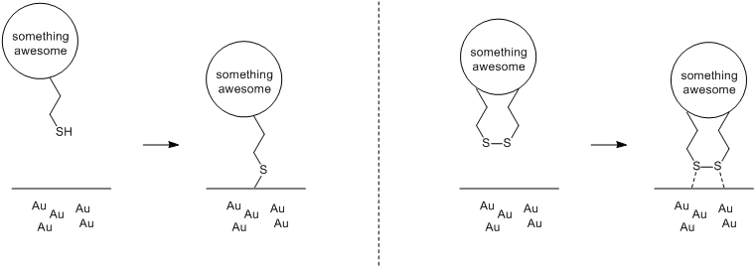
Clase 3. Introducción a la Nanotecnología. Propiedades de la materia en la nano-escala. Resonancia Superficial Plasmones
The Steps of an Assay
In the simplest case of an SPR measurement, a target component or analyte is captured by the capturing element or so-called ligand. The ligand is permanently immobilized on the sensor surface previous to the measurement.
Various sensor surfaces with immobilized ligands are commercially available, and many more can be custom-made.
In the simplest case, the event of capturing the analyte by the ligand gives rise to a measurable signal, this is called direct detection. Each measurement starts with conditioning the sensor surface with a suitable
buffer solution (1). It is of vital relevance to have a reliable baseline before the
capturing event starts. At this point, the sensor surface contains the active
ligands, ready to capture the target analytes.
Schematic representation of direct detection: the analyte is captured by the ligands (Y) immobilized on the sensor surface. Accumulation of the analyte results in a refractive index change in the evanescent field shifting the SPR angle. Here the ligand is immobilized in a hydrogel.

Slide 14
Clase 3. Introducción a la Nanotecnología. Propiedades de la materia en la nano-escala. Resonancia Superficial Plasmones
Calibration Curve
Apart from kinetic and thermodynamic studies, SPR measurements can also be used for the determination of the concentration of the analyte in a sample (quantitative analysis).
In this case, first different concentrations of the analyte are applied in separate analysis cycles. The sensorgrams measured at different concentrations give an overlay plot similar to that depicted in Figure 1.5, with the plateaus of the association step increasing at increasing analyte concentration.
A calibration curve can be constructed by plotting the response (DR) after a
certain time interval (t1) versus concentration.
When analyzing samples with an unknown concentration of the analyte,
usually multiple dilutions are made, for example 10, 100 and 1000 times, or for more accurate determinations serial dilutions by a factor of 2. If the concentration

Slide 15
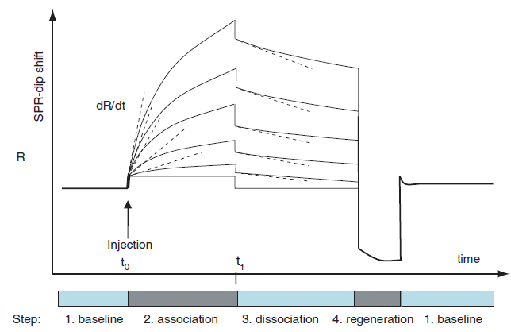
Clase 3. Introducción a la Nanotecnología. Propiedades de la materia en la nano-escala. Resonancia Superficial Plasmones
Typical overlay plot of sensorgrams from serial diluted analyte concentrations.
Just after injection at t0 a sample specific binding of the analyte occurs and mass transport to the surface is rate limiting and linearly dependent on the concentration. From the slopes of a positive control (dR/dt), the concentration of an unknown sample can be determined.
During the association phase the number of unbound ligand molecules
decreases and dissociation takes place. The off-rate constant or dissociation
constant (kd) can be determined after injecting dissociation buffer at t1.

Slide 16
Clase 3. Introducción a la Nanotecnología. Propiedades de la materia en la nano-escala. Resonancia Superficial Plasmones
SPR sensing means detection of refractive index changes at the sensor surface, which in practice translates to the amount of mass deposited at the sensor surface. Direct detection is only possible if the capturing event of the analyte brings about measurable refractive index changes. This is easier to achieve if the molecular weight of the analyte is high (i.e. around 1000 Da or higher). However, for small molecules to produce a measurable refractive index change, large numbers would be required, making the analysis intrinsically less sensitive. If the analyte is a small molecule (MWo1000 Da), often direct detection is not viable.
Detection of small molecules can be carried out using a different strategy. Most often, small molecules are detected in a sandwich, competition or inhibition
assay format. In all assay formats, not only the lower detectable concentration is limited, but also the physical number of immobilized elements on the sensor surface, which provides a maximum limiting value

Slide 17
Clase 3. Introducción a la Nanotecnología. Propiedades de la materia en la nano-escala. Resonancia Superficial Plasmones
Measurement Configurations
There are three different configurations for generating the plasmon and measuring the angle:
- Attenuated total reflection
- Laser coupling in a waveguide.
- Coupling in a grating. The incident light is guided along an optical fibre to an etched grating (ideal sinusoidal shape with 2,400 lines/mm) coated with a thin metal film. At the end of the waveguide, a photodiode measures the attenuation of the wave by the plasmon resonance.
Source: usually a LED, a laser diode, or a P polarised (parallel to the plane of the surface) solid-state laser.
Detector: photodiode array or a CMOS or CCD camera in the case of multispot systems, or a single detector mounted on a goniometric arm. The Nomadics Spreeta made by Texas Instruments is a good example of a low-cost miniature sensor .
Light source is a polarised LED illuminating a gold surface. The reflected light is measured by a photodiode array. The whole object is moulded into a plexiglas matrix. The user must provide a microfluidic chamber which is brought into contact with the sensor to convey and evacuate samples. This chamber is often made from polydimethylsiloxane (PDMS) and its dimensions depend on the application (required flow rate, need for heat control, and so on).
Among the manufacturers of industrial SPR equipment are Biacore, Autolab SPR, Genoptics, Plasmonic, Reichert, and Ibis Biosensor. Each of these also offers biological protocols designed for different target applications

Slide 18
Clase 3. Introducción a la Nanotecnología. Propiedades de la materia en la nano-escala. Resonancia Superficial Plasmones
From Dip to Real-time Measurement
SPR is not only suited to measure the difference between two states, but can also monitor the change in time, if one follows in time the shift of the resonance angle at which the dip is observed. Figure depicts the shift of the dip in time, a so-called sensorgram. If this change is due to a biomolecular interaction, the kinetics of the interaction can be studied in real time.
SPR sensors investigate only a very limited vicinity or fixed volume at the metal surface. The penetration depth of the electromagnetic field (so-called evanescent field) at which a signal is observed typically does not exceed a few hundred nanometers, decaying exponentially with the distance from the metal layer at the sensor surface. The penetration depth of the evanescent field is a function of the wavelength of the incident light.
SPR sensors lack intrinsic selectivity: all refractive index changes in the evanescent field will be reflected in a change of the signal. To permit selective detection at an SPR sensor, its surface needs to be modified with ligands suited for selective capturing of the target compounds but which are not prone to adsorbing any other components present in the sample or buffer media
NPs can be immobilized onto sensor surfaces by different approaches. Liposomes can be stably captured by sensor surfaces exposing protruding lipophilic alkyl chain anchors, which insert into the lipidic layer of the NP . Figure 2 reports the data obtained in our lab using this approach and showing the efficient and long-lasting capture of different types of liposomes.
The maximal capture varied from 700 RU (GM1 liposomes) to 10,000 RU (plain liposomes). Since the size of the tested liposomes were very similar (≈140 nm), the differences are likely due to the lipid composition, in agreement with previous data: in particular, it had already been shown that negatively charged liposomes deposited less densely due to electrostatic repulsion. The dissociation rate was very slow, always lower than 2 × 10−4 s−1, corresponding to less than 10% dissociation in ten minutes, and allowing the subsequent injection (binding) of analytes onto captured nanoliposomes

Slide 19
Clase 3. Introducción a la Nanotecnología. Propiedades de la materia en la nano-escala. Resonancia Superficial Plasmones
SPR is a powerful label-free method widely used to study binding between two macromolecules. Typically, one of the two interacting partners is immobilized on a sensor chip surface, and the other is flowed through a microfluidic system in contact with the chip surface. Binding is revealed in real time as a change of mass at the surface, and the interaction can be characterized in terms of on and off rates (kinetics) and binding strength (affinity) [16]. Due to these features, SPR has the potential for being a technique of choice for a rapid and quantitative in vitro method to characterize, screen and develop NPs for biomedical purposes
Figure 1. SPR approaches to study interactions between functionalized NPs and their putative biological targets. (a) Flowing of the target onto ligand-functionalized NPs immobilized on the sensor surface. (b) Flowing of ligand-functionalized NPs onto
immobilized target (note the possibility that multivalent interactions underlie the binding of a single NP).
Applications of Surface Plasmon Resonance (SPR) for the Characterization of Nanoparticles Developed for Biomedical Purposes
Mara Canovi 1, Jacopo Lucchetti 1, Matteo Stravalaci 1, Francesca Re 2, Davide Moscatelli 3, Paolo Bigini 1, Mario Salmona 1 and Marco GobbiSensors 2012, 12, 16420-16432; doi:10.3390/s121216420

Slide 20
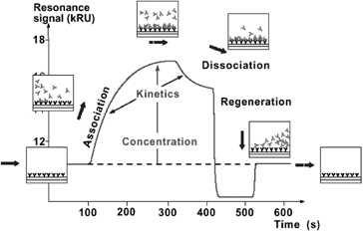
Clase 3. Introducción a la Nanotecnología. Propiedades de la materia en la nano-escala. Resonancia Superficial Plasmones
As Biacore® biosensors had been proven to be a successful platform for detecting low-level chemical contaminants and toxins in food products, the Biacore Q platform was selected for assay development for the monitoring of PSP toxins (Campbell et al. 2007; Fonfria et al. 2007)
This biosensor-based assay measured the real-time interaction of a specific biological recognition element or binder with a target toxin immobilised onto the sensor chip surface. A typical sensorgram, a measure of the binding response against time. The running buffer flowing over the surface established the baseline value and as the sample solution passed over the sensor surface, the profile of the molecular interaction appeared. During injection the observed binding rate was the difference between the molecules binding to the surface and molecules leaving the surface. Consequently, binding appears fastest at the beginning of the injection as the binder in the sample readily interacts with the high concentration of available toxin-binding partners on the sensor surface. As the injection continues, the observed rate of binding decreased as fewer toxin molecules are available on the surface.
After the injection was complete, the binder dissociated and was washed away by the continuous flow of buffer. The sensor surface was regenerated back to the baseline value for the analysis of the next sample (Campbell et al. 2007).
SPR optical biosensor sensorgram of the molecular interaction between the binder and immobilised surface. Source: Abery (2001). Courtesy: Biacore International AB, GE Healthcare.

Slide 21
Clase 3. Introducción a la Nanotecnología. Propiedades de la materia en la nano-escala. Resonancia Superficial Plasmones
Applications
This type of equipment has applications to food safety and defense (rapid detection of pathogens or chemical contamination), but also water quality and medical diagnosis.
More precisely, these systems can detect the following interactions:
• protein/protein,
• DNA/DNA,
• protein/DNA,
• lipid/protein,
• hybrid molecular systems,
• non-biological surfaces (chemical products or gases dissolved in a liquid phase).
Since these interactions can be measured by many other methods, one ought to ask what advantages and disadvantages set SPR apart from conventional approaches.
Detection of biomolecular binding, the adsorption of thin bio-films or conformational changes of macromolecules

Slide 22
Advantages and Disadvantages of SPR
The main drawback with this type of analysis is the need to work directly in contact with the gold surface.
The main approach to anchoring molecules onto the gold is binding via thiols, but this type of binding is not very resistant and molecules immobilised on the surface are observed to desorb during analysis.
Another method involves polymerising a pyrrole monomer, but this technique is not standardised and requires significant technical knowhow.
Finally, a layer of dextran can be used, but this layer is rather thick and its porosity means that interactions cannot always be considered to occur at the surface. An alternative method is to deposit a thin film of silica on the gold layer, and anchor molecules by means of silane binding. The resonance is then observed to shift, but without too much attenuation. This technique is nevertheless only rarely used, because the Biacore kits with thiol or dextran binding are so well established and so well suited to users’ needs.
Some manufacturers, including Texas Instruments, have designed throwaway SPR biosensors. For their part, reusable sensors require accurate and rigorous cleaning.
SPR biosensors do have one huge advantage, however, in that targets do not have to be labelled and the protocol for their use is extremely simple. As an example, this means that more samples can be analysed in a given time, and for a lesser cost, so that, in certain cases, the alert can be given more quickly.
Although it is less sensitive than methods using fluorescent labeling, it is nevertheless sensitive enough for many applications (typically 1 nM for antigen/ antibody reactions). The robustness and compactness of existing systems are also major arguments in favour of the technique.

Slide 23
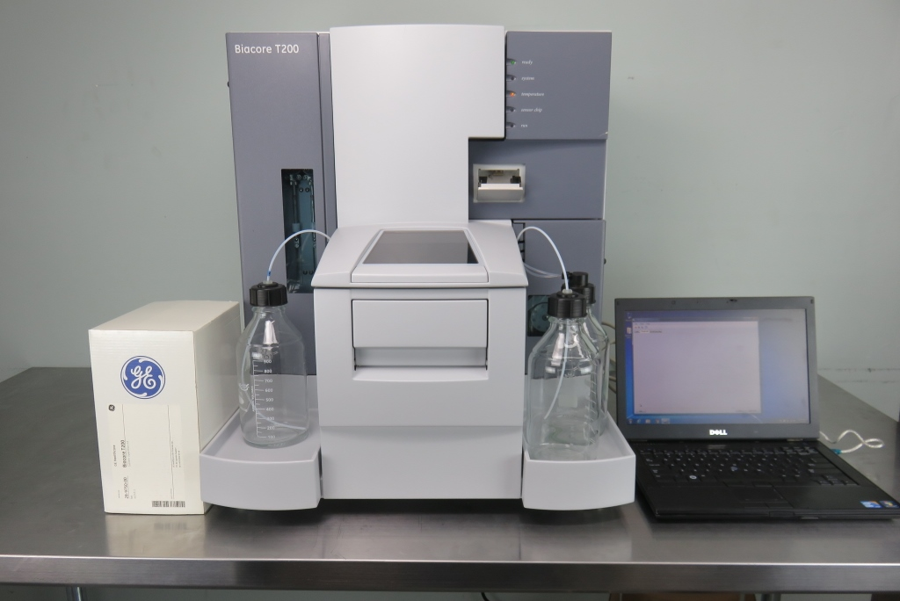
The GE Biacore T200 SPR Analyzer has exceptional sensitivity, extending the limitations of label-free interaction analysis. This molecular interaction analysis system monitors in real-time, label-free interactions, delivering high quality data, which is rich in information. Analysis is highly sensitive, and can be done on reagent ranges from ions to viruses. Offering a powerful and versatile solution for obtaining kinetic, concentration, specificity, affinity, selectivity, and thermodynamic data, the GE Biacore T200 SPR analyzer can be used for multiple applications. Biacore SPR analyzer enables measurement of kinetic constants over the broadest range, from the fastest on-rates to the slowest off-rates.
Designed to support large-scale applications, the SPR analyzer supports 96 and 384 well microplates in a temperature controlled compartment and can be run for 48 hours, unattended. Using an integrated buffer degasser, data quality at high temperatures is reliable, with analysis ranges of 4°C to 45°C. The GE Biacore T200 SPR analyzer is well suited to multiple applications involving biomolecular interactions. Interactions such as defining potential drug targets and diagnostic markers, understanding molecular mechanisms and structure-function relationships, and vaccine development. The GE Biacore T200 evaluation software can be operated with a few clicks, and enables kinetic and affinity evaluations of interactions. It has flexible tools for customizing your data reporting and processing. Processing can be performed in one single evaluation with data from either one or several runs. Contact us today with questions about our GE Biacore T200.

Slide 24
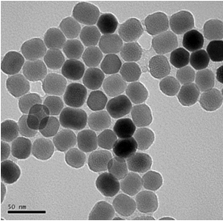


Clase 3. Introducción a la Nanotecnología. Origen del color de los metales (bulk)
Au macroscópico (bulk)
nanoAu [2 nm diámetro]

Slide 25
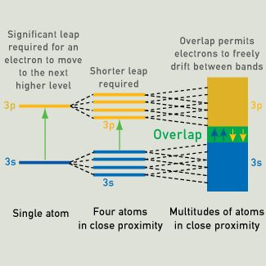
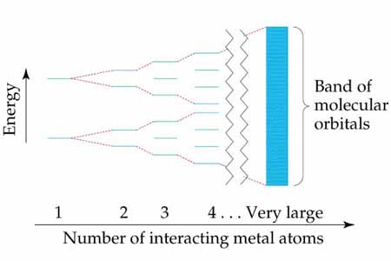
Clase 3. Introducción a la Nanotecnología. Origen del color de los metales (bulk)
Band Theory
The color of metals can be explained by band theory, which assumes that overlapping energy levels form bands.
The mobility of electrons exposed to an electric field depends on the width of the energy bands, and their proximity to other electrons. In metallic substances, empty bands can overlap with bands containing electrons. The electrons of a particular atom are able to move to what would normally be a higher-level state, with little or no additional energy. The outer electrons are said to be "free," and ready to move in the presence of an electric field.
The highest energy level occupied by electrons is called the Fermi energy, Fermi level, or Fermi surface.

Slide 26
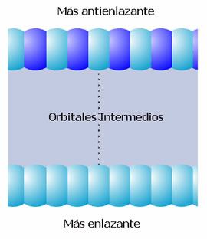
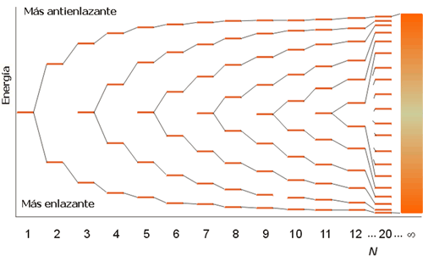
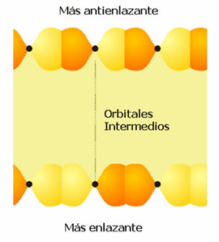
Clase 3. Introducción a la Nanotecnología. Origen del color de los metales (bulk)
Orbitales moleculares y banda s.
Formación de una banda de orbitales moleculares.
Orbitales moleculares y banda p.

Slide 27
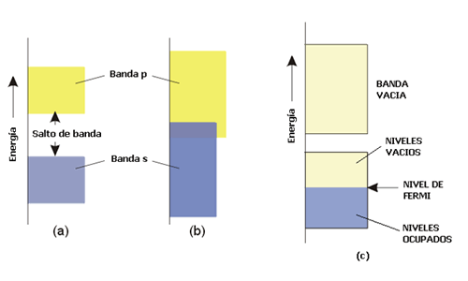
Clase 3. Introducción a la Nanotecnología. Origen del color de los metales (bulk)
La densidad de estados.
El número de niveles de energía con un determinado valor de energía se conoce como la densidad de estados, N(E) o ρ. Es posible representar la variación de energía de una banda en función de la densidad de estados, tal como aparece en la Figura 8 para las bandas s y p. La densidad de estados no es uniforme a lo largo de toda la banda debido a que los niveles de energía se empaquetan más a unos determinados valores de energía que a otros. Este hecho produce que la banda s, por ejemplo, presente la mayor densidad de estados en el centro y la menor densidad de estados en los extremos de la banda. La razón de este comportamiento está en la forma de las combinaciones lineales que originan los orbitales moleculares que constituyen la banda s. Existe una única combinación lineal que conduce al orbital molecular más enlazante (el límite inferior de la banda)y otra que conduce al más antienlazante (el límite energético superior de la banda). Sin embargo hay varias combinaciones posibles, degeneradas en energía, que dan lugar a los orbitales moleculares que forman la parte central de la banda s.
(a) y (b) Bandas s y p, que pueden solapar o no, dependiendo de la anchura. (c) Niveles ocupados y nivel de Fermi a o K.

Slide 28
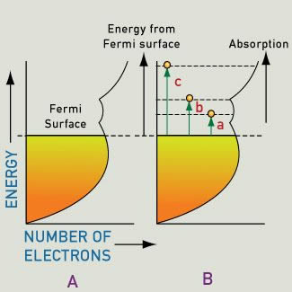
Clase 3. Introducción a la Nanotecnología. Origen del color de los metales (bulk)
If the efficiency of absorption and re-emission is approximately equal at all optical energies, then all the different colors in white light will be reflected equally well. This leads to the silver color of polished iron and silver surfaces.
The efficiency of this emission process depends on selection rules. However, even when the energy supplied is sufficient, and an energy level transition is permitted by the selection rules, this transition may not yield appreciable absorption. This can happen because the energy level accommodates a small number of electrons.
For most metals, a single continuous band extends through to high energies. Inside this band, each energy level accommodates only so many electrons (we call this the density of states). The available electrons fill the band structure to the level of the Fermi surface and the density of states varies as energy increases (the shape is based on which energy levels broaden to form the various parts of the band).
If the efficiency decreases with increasing energy, as is the case for gold and copper, the reduced reflectivity at the blue end of the spectrum produces yellow and reddish colors.
Above the Fermi level, energy levels are empty (empty at absolute zero), and can accept excited electrons. The surface of a metal can absorb all wavelengths of incident light, and excited electrons jump to a higher unoccupied energy level. This creates current, which rapidly discharges to emit a photon of light of the same wavelength. So, most of the incident light is immediately re-emitted at the surface, creating the metallic luster we see in gold, silver, copper, and other metals. This is why most metals are white or silver, and a smooth surface will be highly reflective, since it does not allow light to penetrate deeply
http://www.webexhibits.org/causesofcolor/9.html

Slide 29
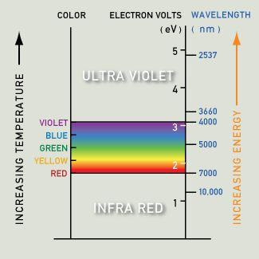
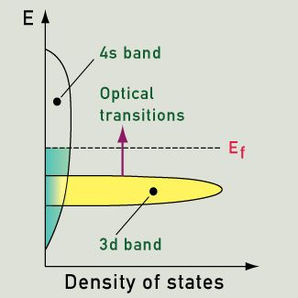
Clase 3. Introducción a la Nanotecnología. Origen del color de los metales (bulk)
Showing the variation of density of states and the excitation seen in gold, silver and copper (actually from the 3d band to above the Fermi level)
http://www.webexhibits.org/causesofcolor/9.html

Slide 30
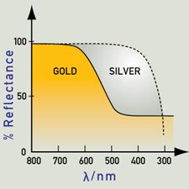
Clase 3. Introducción a la Nanotecnología. Origen del color de los metales (bulk)
Silver, gold and copper have similar electron configurations, but we perceive them as having quite distinct colors. Electrons absorb energy from incident light, and are excited from lower energy levels to higher, vacant energy levels. The excited electrons can then return to the lower energies and emit the difference of energy as a photon.
If an energy level (like the 3d band) holds many more electrons (than other energy levels) then the excitation of electrons from this highly occupied level to above the Fermi level will become quite important. Gold fulfills all the requirements for an intense absorption of light with energy of 2.3 eV (from the 3d band to above the Fermi level). The color we see is yellow, as the corresponding wavelengths are re-emitted. Copper has a strong absorption at a slightly lower energy, with orange being most strongly absorbed and re-emitted. In silver, the absorption peak lies in the ultraviolet region, at about 4 eV. As a result, silver maintains high reflectivity evenly across the visible spectrum, and we see it as a pure white. The lower energies (which in this case contain energies corresponding to the entire visible spectrum of color) are equally absorbed and re-emitted.
Silver and aluminum powders appear black because the white light that has been re-emitted is absorbed by nearby grains of powder and no light reaches the eye.
Metals are colored because the absorption and re-emission of light are dependent on wavelength. Gold and copper have low reflectivity at short wavelengths, and yellow and red are preferentially reflected, as the color here suggests. Silver has good reflectivity that does not vary with wavelength, and therefore appears very close to white.
http://www.webexhibits.org/causesofcolor/9.html

Slide 31
Seminario 2. Introducción a la Nanotecnología. Propiedades de la materia en la nano-escala. Nuevos efectos en la nano-escala
Propiedades ópticas relevantes en la nanoescala
I = T+A+R
I = luz incidente en un material
T= transmisión: pasaje de luz a través de un material (complementaria a A)
R= reflexión: ocurre cuando la λ luz incidente llega a una superficie “smooth” . λ luz reflejada es idéntica a la incidente
A= absorción (dependiente de estructura química; transiciones è, vibracionales, rotacionales)
Scattering: ocurre cuando luz incidente llega a una superficie con dimensiones comparables a su λ

Slide 32
Clase 3. Introducción a la Nanotecnología. Propiedades de la materia en la nano-escala. Nuevos efectos en la nano-escala
dispersión por clusters secuenciales: múltiple scattering
Scattering: ocurre cuando luz incidente llega a una superficie con dimensiones comparables a su λ
Proceso FISICO que depende del tamaño del cluster, su índice de refracción y el índice de refracción del medio de suspensión
El máximo scattering ocurre para λ doble tamaño del cluster :
clusters 200 nm⇒ λ 400 nm
Front scattering
I = T+A+R
Back scattering
Macroescala: back /front scattering

Slide 33
Clase 3. Introducción a la Nanotecnología. Propiedades de la materia en la nano-escala. Nuevos efectos en la nano-escala
Extinción (atenuación) = absorción + scattering
Absorption crosss section
(sección transversa de absorción)[m²] = total power absorbed by a particle/density of flux power that falls on the particle
Scattering crosss section
(sección transversa de scattering)[m²] = total power scattered by a particle/density of flux power that falls on the particle
irradiancia = intensidad de luz por unidad de área [una particula remueve energía del haz incidente de acuerdo a su cross section [unidades de superficie]

Slide 34
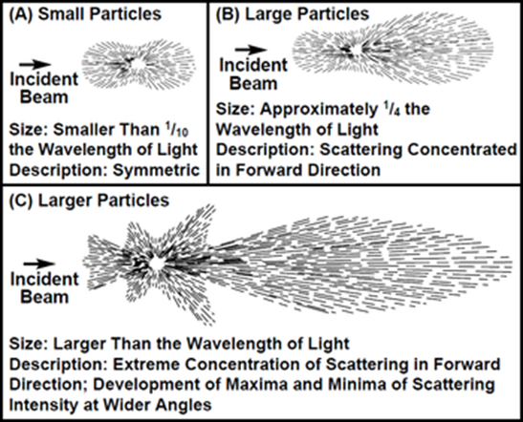
Clase 3. Introducción a la Nanotecnología. Propiedades de la materia en la nano-escala. Nuevos efectos en la nano-escala
Particles interact with incident light absorbing it and scattering it in all directions. The spatial distribution of scattered light depends on the ratio of particle size to wavelength of incident light. Particles much smaller than the wavelength of incident light exhibit a fairly symmetrical scattering distribution with approximately equal amounts of light scattered both forward and backward (Figure A). As particle sizes increase in relation to wavelength, light scattered from different points of the sample particle create interference patterns that are additive in the forward direction. This constructive interference results in forward-scattered light of a higher intensity than light scattered in other directions (Figures B and C). In addition, smaller particles scatter shorter (blue) wavelengths more intensely while having little effect on longer (red) wavelengths. Conversely, larger particles scatter long wavelengths more readily than they scatter short wavelengths of light. Particle shape and refractive index also affect scatter distribution and intensity. Spherical particles exhibit a larger forward-to-back scatter ratio than coiled or rod shaped particles. The refractive index of a particle is a measure of how it redirects light passing through it from another medium such as the suspending fluid. The particle’s refractive index must be different than the refractive index of the sample fluid in order for scattering to occur. As the difference between the refractive indices of suspended particle and suspending fluid increases, scattering becomes more intense. The color of suspended solids and sample fluid are significant in scattered-light detection. A colored substance absorbs light energy in certain bands of the visible spectrum, changing the character of both transmitted light and scattered light and preventing a certain portion of the scattered light from reaching the detection system. Light scattering intensifies as particle concentration increases. But as scattered light strikes more and more particles, multiple scattering occurs and absorption of light increases. When particulate concentration exceeds a certain point, detectable levels of both scattered and transmitted light drop rapidly, marking the upper limit of measurable turbidity. Decreasing the path length of light through the sample reduces the number of particles between the light source and the light detector and extends the upper limit of turbidity measurement.
Brumberger, et al, “Light Scattering”, Science and Technology, November, 1968, page 38.

Slide 35
Clase 3. Introducción a la Nanotecnología. Propiedades de la materia en la nano-escala. Nuevos efectos en la nano-escala
Generación de color en nanopartículas
Color debido a… | Ejemplo de nanomaterial
Interferencia: interferencia constructiva en la interacción con nanomaterial | Alas de mariposa [cristales fotónicos] Cristales líquidos [jabones]
Scattering: diferentes tamaños de partículas dispersan distintas λ | Coloides (leche)
Surface plasmons: en nanopartículas metálicas, causa colores intensos | Coloides metálicos (nanoAu)
Quantum fluorescence: el confinamiento cuántico en semiconductores nanoparticulados, produce niveles de energía desde donde puede ser emitida (fluorescencia) luego de absorbida por el semiconductor | Semiconductores (Quantum-dots:Qdots)

Slide 36
Clase 3. Introducción a la Nanotecnología. Propiedades de la materia en la nano-escala. Resonancia Superficial Plasmones
As an example of how drastically the number of surface atoms increases with decreasing particle size, consider a cube of iron 1 cm on an edge. The percentage of surface atoms would be only 10­ ⁻⁵ %. Dividing the same cube into smaller cubes with an edge of just 10 nm results in a percentage of surface atoms of 10% and in a cube with an edge of 1 nm every atom would be a surface atom. This might illustrate why changes in the size range of a few nanometres are expected to lead to great changes in the physical and chemical properties of the nanoparticle.

Slide 37
Clase 3. Introducción a la Nanotecnología. Propiedades de la materia en la nano-escala. Resonancia Superficial Plasmones localizada [Localized SPR]
Plasmones superficiales: color en coloides metálicos
Color de nanopartículas metálicas: debido al efecto localized surface plasmon resonance (SPR)
Parte de la luz se desplaza sobre la superficie, originando un grupo de electrones superficiales de conducción que se propaga en una dirección paralela a la interfase metal/dieléctrico o metal/vacío) (plasmon superficial)
Luz incidente sobre superficie metálica de material cualquier tamaño
Nanomaterial: plasmones se hallan confinados a sectores: oscilan [ida y vuelta] sincronizadamente en un pequeño sector de espacio: resonancia de plasmon localizado en superficie (LSPR)
Cuando ν oscilación plasmon = ν luz incidente, se dice que están en resonancia
Material bulk: plasmones se mueven libremente sobre la superficie
La energía de LSPR es sensible a la función de dieléctrico del material circundante, a la forma y tamaño de la nanoparticula

Slide 38

Clase 3 . Introducción a la Nanotecnología. Propiedades de la materia en la nano-escala. Localized SPR
Picture of gold nanoparticles embedded within Roman cup. When light is shown through the cup the gold nanoparticles reflect the red making it appear to change color. Source: http://www.smithsonianmag.com/history/this-1600-year-old-goblet-shows-that-the-romans-were-nanotechnology-pioneers-787224/?no-ist
Lycurgus Bronze Cup, which dates
from the fourth century AD. This cup has inlaid glass that is able to disperse green
light and transmit red light because it contains metal nanoparticles of about 70 nm,
which were synthesizable thanks to an alloy of silver (70%) and gold (30%)
Surface plasmon resonance
The enchantment of Au NPs since ancient times, as reflected in their intense color, originates from the basic photophysical response that does not exist to nonmetallic particles. When a metal particle is exposed to light, the oscillating electromagnetic field of the light induces a collective coherent oscillation of the free electrons (conduction band electrons) of the metal. This electron oscillation around the particle surface causes a charge separation with respect to the ionic lattice, forming a dipole oscillation along the direction of the electric field of the light

Slide 39
Clase 3. Introducción a la Nanotecnología. Propiedades de la materia en la nano-escala. Resonancia Superficial Plasmones localizada [Localized SPR]
Localized surface plasmon resonance (LSPR) is an optical phenomena generated by a light wave trapped within conductive nanoparticles (NPs) smaller than the wavelength of light. The phenomenon is a result of the interactions between the incident light and surface electrons in a conduction band. This interaction produces coherent localized plasmon oscillations with a resonant frequency that strongly depends on the composition, size, geometry, dielectric environment and particle–particle separation distance of NPs.
Common materials used for NP production are noble metals such as Ag and Au, which due to the energy levels of d–d transitions exhibit LSPR in the visible range of the spectrum. Although, Ag exhibits the sharpest and strongest bands among all metals, Au is preferred for biological applications due to its inert nature and biocompatibility, and thiol-gold association for immobilization of biomolecules.
The interaction of NPs with light allows some photons to be absorbed and some to be scattered. NPs undergoing LSPR can have high molar extinction coefficients for absorption, with magnitude of up to about 10¹¹ M−1 cm−1, and Rayleigh scattering that can be many orders of magnitude larger than without LSPR .
For example, a single 80-nm Ag nanosphere has been reported to scatter 445 nm light with a cross-section of 3 × 10⁻² m². This is six orders of magnitude greater than the cross-section of capture of a fluorescein molecule, and three orders of magnitude greater than the cross-section of the nanosphere of the same size filled with fluorescein.
Unlike fluorophores, plasmonic NPs do not photobleach or blink and thus can serve as intense and robust labels for biosensors, immunoassays, cellular imaging and surface enhanced spectroscopies.
The extremely intense and highly localized electromagnetic (EM) fields induced by LSPR make NPs highly sensitive transducers of small changes in the local refractive index. These changes are exhibited in spectral shifts of extinction (absorption plus elastic light-scattering) and scattering spectra.
For many organic molecules with a relatively high refractive index compared to solvent or air, binding to NPs results in a redshift. Additionally, strong EM fields enhance spectral information for surface-enhanced Raman spectroscopy (SERS), metal-enhanced fluorescence (MEF), plasmon resonance energy transfer (PRET) , and nanoplasmonic molecular rulers .
Localized surface plasmon resonance: Nanostructures, bioassays and biosensing—A review Eleonora Petryayeva, Ulrich J. Krull Analytica Chimica Acta 706 (2011) 8–24

Slide 40
Clase 3. Introducción a la Nanotecnología. Propiedades de la materia en la nano-escala. Resonancia Superficial Plasmones localizada [Localized SPR]
Origin of LSPR
The general optical properties of NPs differ significantly from those that are observed in bulk material. Metallic NPs that are of interest have dimensions that place them in the quantum size regime. Continuous electron bands become discrete, and properties such as plasmon resonance will scale with NP size and the extent of aggregation of NPs. Upon plane-wave excitation of a small NP (R/λ < 0.1, where R is the radius of the NP and λ is the wavelength of the incident light), the oscillating electric field causes coherent oscillation of conduction electrons. This effect leads to the accumulation of polarization charges on the surface of a NP. When only dipole oscillations contribute to the extinction cross-section, C_{ext}, Mie’s solution of Maxwell’s equation can be used to obtain the spectrum for well separated NPs
For nanoparticles much smaller than the wavelength of the light (25 nm), the dipole oscillation is dominant and the extinction cross section is simplified to the following well known expression
ε_{m} is the dielectric constant of the surrounding medium
ε = ε_{r} + iε_{i} is the complex dielectric constant of the bulk metal
The real part of the dielectric constant of the metal determines the SPR position and the imaginary part
determines the bandwidth.
λ is the wavelength of the incident light, R is the radius of the NP, N is the electron density,
The factor χ that appears in Eq. (1) accounts for the shape of the particle, and is assigned a magnitude of two for a spherical particle and can be as large as 20 for particles with high aspect ratios such as nanorods.
The surface plasmon resonance (Fröhlich frequency) peak that gives rise to the color of the spherical NP is observed when ε_{r} = −2ε_{m}. This represents a condition at which the EM field is enhanced, while polarization undergoes singularity as the denominator goes to zero. For Ag and Au NPs this condition is met in the visible region, making these materials suitable for numerous applications involving color.
Eq. (1)
The LSPR is dependent on factors affecting the electron charge density on the particle surface, such as the particle size, shape, structure, and the dielectric properties of the metal and the surrounding medium. Spherical gold, silver, and copper nanoparticles have strong SPR band in the visible region, while other metals show broad and weak bands in the UV region.
Hollow or core-shell structures show a very red shifted band of the LSPR wavelength compared to the solid structures.
Anisotropic nanoparticles, such as rods, triangles, and branched structures also exhibit a red shifted SPR band compared to their spherical analogs.

Slide 41
Clase 3. Introducción a la Nanotecnología. Propiedades de la materia en la nano-escala. Resonancia Superficial Plasmones localizada [Localized SPR]
The oscillation of conduction electrons displaces the electron cloud relative to the nuclei, giving rise to a restoring force from coloumbic attraction resulting in oscillation of the electron cloud with respect to the nuclei. This restoring force permits the resonance condition to occur at a specific frequency with electrons exhibiting a π/2 phase lag with respect to the field of incident radiation. The resonantly enhanced field inside the NP leads to the dipolar field that is exterior to the NP. It is the dipolar field that is responsible for enhanced absorption and scattering cross-sections, as well as strongly enhanced EM fields in close vicinity of the NP surface.
A thin gold film (30–50 nm) absorbs throughout the visible and near-infrared region, while a dipolar surface plasmon resonance of a 30-nm Au NP is concentrated at 2.25 eV (ca. 552 nm). These collective oscillations of dipole plasmon resonance are governed by the shape and size of electron distribution, density of the electrons and effective electron mass
The magnitude of the spectral shift of LSPR extinction, or the scattering wavelength maximum for small NPs is described by the following relationship
Eq. (8)
where m is the bulk refractive index response of the NP, also known as the sensitivity factor (in nm per refractive index unit, RIU), n is the change in refractive index (in RIU), d is the effective thickness of the adsorbed layer (in nm) and ld is the characteristic EM field decay length (in nm). It is the expression given in Eq. (8) that serves as the foundation that explains the LSPR wavelength-shift (refractive index) arising in chemical assays and bioassays that probe the affinity between molecules at the surface of nanostructures.
This LSPR is the result of the interaction of nanoparticles with light of resonant frequency. As a result of the absorption of resonant light, the free electrons of the metal exhibit a collective coherent oscillation around the nanoparticle surface. This coherent oscillation induced as a result of the absorption of light in resonance with the incident light is called the localized surface plasmon resonance. This plasmon resonance leads to a strong extinction band around 520 nm in the visible spectral region, which is the reason for the brilliant red color of the nanogold solution.
Plasmonic photo-thermal therapy (PPTT) Xiaohua Huang a, Mostafa A. El-SayedAlexandria Journal of Medicine (2011) 47, 1–9

Slide 42
Clase 3. Introducción a la Nanotecnología. Propiedades de la materia en la nano-escala. Localized SPR
Plasmonic (noble metal) nanoparticles distinguish themselves from other nanoplatforms such as semiconductor quantum dots, magnetic and polymeric nanoparticle by their unique localized surface plasmon resonance (LSPR). This LSPR, resulting from photon confinement to a small particle size, enhances all the radiative and nonradiative properties of the nanoparticles and thus offering multiple modalities for biological and medical applications.
Gold nanoparticles: Optical properties and implementations in cancer diagnosis and photothermal therapy Xiaohua Huang a,b, Mostafa A. El-Sayed Journal of Advanced Research (2010) 1, 13–28

Slide 43
Clase 3. Introducción a la Nanotecnología. Propiedades de la materia en la nano-escala. Localized SPR
Extinction spectra of gold nanoparticles in different sizes. The electric field of incident light induces coherent collective oscillation of conduction band electrons with respective to the positively charged metallic core. This dipolar oscillation is resonant with the incoming light at a specific frequency that depends on particle size and shape. For gold nanoparticles (≈ 10 nm diametro), the SPR wavelength is around 520 nm depending on the size of the nanoparticles: a mayor tamaño hay un corrimiento al rojo

Slide 44
Clase 3. Introducción a la Nanotecnología. Propiedades de la materia en la nano-escala. Localized SPR
Surface plasmon absorption and scattering
The energy loss of electromagnetic wave (total light extinction) after passing through a matter results from two contributions: absorption and scattering processes. Light absorption results when the photon energy is dissipated due to inelastic processes.
Light scattering occurs when the photon energy causes electron oscillations in the matter which emit photons in the form of scattered light either at the same frequency as the incident light (Rayleigh scattering) or at a shifted frequency (Raman scattering).
The frequency shift corresponds to the energy difference created molecular motion within the matter (molecular bond rotations, stretching or vibrations). Due to the SPR oscillation, the light absorption and scattering are strongly enhanced, 5–6 orders of magnitude stronger than most strongly absorbing organic dye molecules and than the emission of most strongly fluorescent molecules, respectively.
Tuning of the relative contribution of surface plasmon absorption and scattering by changing the particle size. The calculated surface plasmon absorption, scattering and total extinction efficiencies of gold nanoparticles in diameter of (A) 20 nm; (B) 40 nm and (C) 80 nm. (D) The dependence of the ratio of the scattering to absorption cross-sections to on the diameter of gold nanoparticles. Increase particle sizes lead to increased contribution from Mie scattering. The calculations are made by using full Mie theory
absorción
resultante
scattering
Plasmonic photo-thermal therapy (PPTT) Xiaohua Huang a, Mostafa A. El-SayedAlexandria Journal of Medicine (2011) 47, 1–9
The ratio of the scattering to absorption increases dramatically for larger size of particles. For imaging, lager nanoparticles are preferred because of higher scattering efficiency, whereas for photothermal therapy, smaller nanoparticles are preferred as light is mainly adsorbed by the particles and thus efficiently converted to heat for cell and tissue destruction.

Slide 45
Clase 3. Introducción a la Nanotecnología. Propiedades de la materia en la nano-escala. Localized SPR
Schematic illustration of localized surface plasmon resonance (A) and calculated absorption and scattering properties of gold nanoparticles in different sizes (B). The electric field of incident light induces coherent collective oscillation of conduction band electrons with respect to the positively charged metallic core. This dipolar oscillation is resonant with the incoming light at a specific frequency that depends on particle size and shape. The absorption and scattering efficiencies depend on the size of the nanoparticles. Increasing nanoparticle size leads to an increase of light scattering contribution.

Slide 46

Clase 3 . Introducción a la Nanotecnología. Propiedades de la materia en la nano-escala. Nanoesferas de Au
Gold nanoparticles’ interaction with light is strongly dictated by their environment, size and physical dimensions. Oscillating electric fields of a light ray propagating near a colloidal nanoparticle interact with the free electrons causing a concerted oscillation of electron charge that is in resonance with the frequency of visible light. These resonant oscillations are known as surface plasmons. For small (~30nm) monodisperse gold nanoparticles, the surface plasmon resonance phenomenon causes an absorption of light in the blue-green portion of the spectrum (~450 nm) while red light (~700 nm) is reflected, yielding a rich red color. As particle size increases, the wavelength of surface plasmon resonance related absorption shifts to longer, redder wavelengths. Red light is then absorbed, and blue light is reflected, yielding solutions with a pale blue or purple color. As particle size continues to increase toward the bulk limit, surface plasmon resonance wavelengths move into the IR portion of the spectrum and most visible wavelengths are reflected, giving the nanoparticles clear or translucent color. The surface plasmon resonance can be tuned by varying the size or shape of the nanoparticles, leading to particles with tailored optical properties for different applications.
5 nm 100 nm
Peak SPR λ
515-520 nm 572 nm
This phenomenon is also seen when excess salt is added to the gold solution. The surface charge of the gold nanoparticle becomes neutral, causing nanoparticles to aggregate. As a result, the solution color changes from red to blue. To minimize aggregation, the versatile surface chemistry of gold nanoparticles allows them to be coated with polymers, small molecules, and biological recognition molecules. This surface modification enables gold nanoparticles to be used extensively in chemical, biological, engineering, and medical applications.
http://www.sigmaaldrich.com/technical-documents/articles/materials-science/nanomaterials/gold-nanoparticles.html

Slide 47
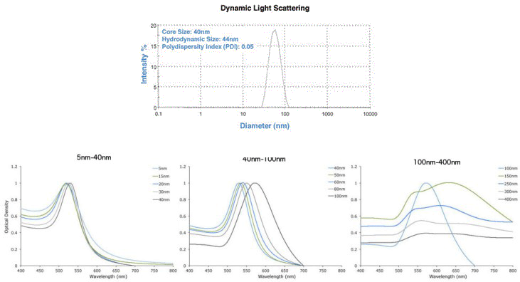
Clase 3 . Introducción a la Nanotecnología. Propiedades de la materia en la nano-escala. Nanoesferas de Au
Figure 2. DLS & UV-Vis spectra showing precise gold nanoparticles from Cytodiagnostics.

Slide 48
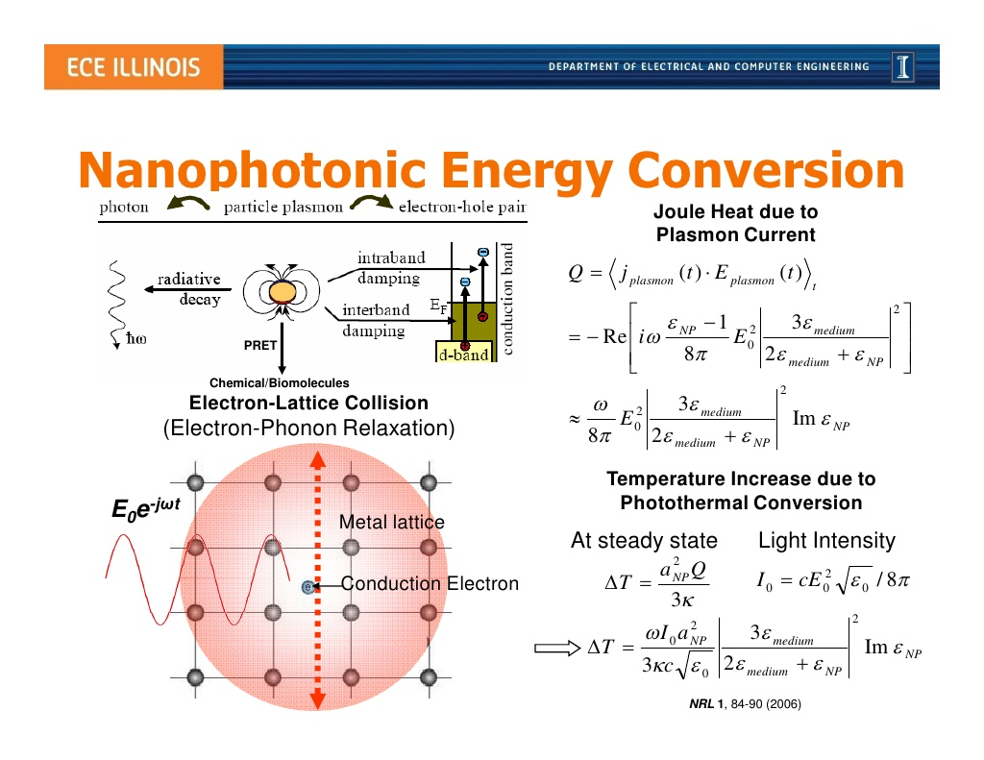

Slide 49
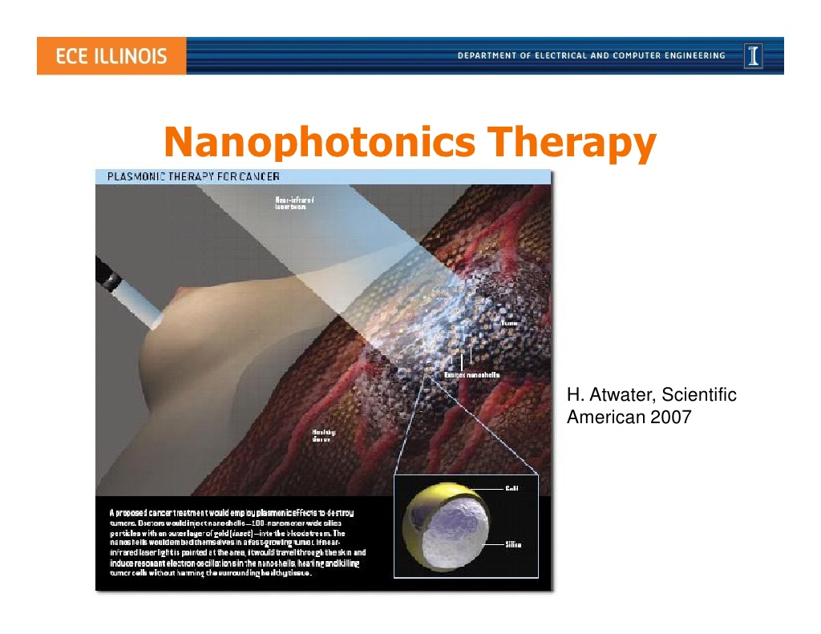

Slide 50
Clase 3. Introducción a la Nanotecnología. Propiedades de la materia en la nano-escala. Nanopartículas de Au
Applications
The range of applications for gold nanoparticles is growing rapidly and includes:
Electronics - Gold nanoparticles are designed for use as conductors from printable inks to electronic chips.¹ As the world of electronics become smaller, nanoparticles are important components in chip design. Nanoscale gold nanoparticles are being used to connect resistors, conductors, and other elements of an electronic chip.
Photodynamic Therapy - Near-IR absorbing gold nanoparticles (including gold nanoshells and nanorods) produce heat when excited by light at wavelengths from 700 to 800 nm. This enables these nanoparticles to eradicate targeted tumors.² When light is applied to a tumor containing gold nanoparticles, the particles rapidly heat up, killing tumor cells in a treatment also known as hyperthermia therapy.
Therapeutic Agent Delivery - Therapeutic agents can also be coated onto the surface of gold nanoparticles.³ The large surface area-to-volume ratio of gold nanoparticles enables their surface to be coated with hundreds of molecules (including therapeutics, targeting agents, and anti-fouling polymers).
Sensors - Gold nanoparticles are used in a variety of sensors. For example, a colorimetric sensor based on gold nanoparticles can identify if foods are suitable for consumption.⁴ Other methods, such as surface enhanced Raman spectroscopy, exploit gold nanoparticles as substrates to enable the measurement of vibrational energies of chemical bonds. This strategy could also be used for the detection of proteins, pollutants, and other molecules label-free.
Probes - Gold nanoparticles also scatter light and can produce an array of interesting colors under dark-field microscopy. The scattered colors of gold nanoparticles are currently used for biological imaging applications.⁵ Also, gold nanoparticles are relatively dense, making them useful as probes for transmission electron microscopy.
Diagnostics - Gold nanoparticles are also used to detect biomarkers in the diagnosis of heart diseases, cancers, and infectious agents.⁶ They are also common in lateral flow immunoassays, a common household example being the home pregnancy test.
Catalysis - Gold nanoparticles are used as catalysts in a number of chemical reactions.⁷ The surface of a gold nanoparticle can be used for selective oxidation or in certain cases the surface can reduce a reaction (nitrogen oxides). Gold nanoparticles are being developed for fuel cell applications. These technologies would be useful in the automotive and display industry.

Slide 51
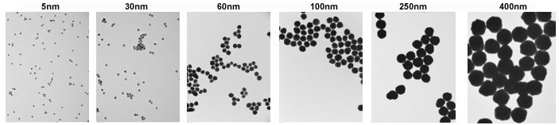
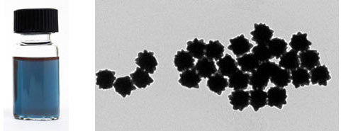
Clase 3. Introducción a la Nanotecnología. Propiedades de la materia en la nano-escala. Nanopartículas de Au
TEM images of 5 nm (left) and 400 nm (right) gold nanoparticles with <8% CV.
Consistent Size and Shape — <10% CV (coefficient of variance) even above 100 nm. Example of 5 nm and 400 nm nanoparticles are shown

Slide 52
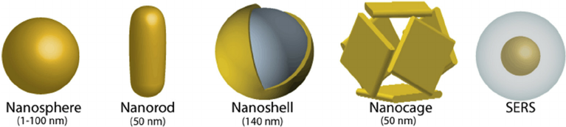
Clase 3 . Introducción a la Nanotecnología. Propiedades de la materia en la nano-escala. Resonancia Superficial Plasmones
Optical tuning by shape and structure
Gold nanorods
Au NPs have fantasized scientist for decades largely due to the ability of optical tuning by synthetic controlling of the particle shape, composition and structure. As predicted by Gan theory in 1915 , when the shape of Au NPs change from spheres to rods, the LSPR band is split into two bands: a strong band in NIR region corresponding to electron oscillations along the long axis, referred to longitudinal band, and a weak band in the visible region at a wavelength similar to that of gold nanospheres, referred to transverse bands. While the transverse band is insensitive to the size changes, the longitudinal band is red shifted largely from the visible to near-infrared region with increasing aspect ratios (Length/Width), causing the color changes from blue to red. Currently, the aspect ratio can be precisely controlled by changing the experimental parameters such as the catalyst of silver ions in the seed-mediated growth method. The nanorods are formed by asymmetric growth of small gold spheres in the presence of shape-forming surfactants, weak reducing agents and the catalysts.

Slide 53
Clase 3 Introducción a la Nanotecnología. Propiedades de la materia en la nano-escala. Resonancia Superficial Plasmones
Tunable optical properties of gold nanorods by changing the aspect ratios. Gold nanorods of different aspect ratios exhibit different dimensions as seen by TEM (A), in different color (B) and different SPR wavelength (C).

Slide 54
Clase 3. Introducción a la Nanotecnología. Propiedades de la materia en la nano-escala. Resonancia Superficial Plasmones
Gold nanoshells
Besides the shape factor for optical tuning into NIR region, structure variation can results in similar phenomenon. Two examples are the gold nanoshells and nanocages. Developed by Halas and co-workers, gold nanoshell is composed of a silica core around 100 nm and a thin shell of gold about few nanometers. The shell is formed by aging the gold clusters attached on the silicon core. The red shift has been explained as the results of the hybridization of the plasmons of the inner sphere and outer cavity. The LSPR wavelength of gold nanoshells can be controlled by changing the shell thickness. Decreasing the thickness of the gold shell from 20 to 5 nm leads to LSPR red shift about 300 nm, which is attributed to the increased coupling between the inner and outer shell surface plasmons for thinner shell particles. Recently, DDA simulation shows that the LSPR frequency depends on the ratio of the shell-to-core thickness in a near-exponential relationship which is independent of the particle size, core and shell material and even surrounding medium.
.

Slide 55
Clase 3. Introducción a la Nanotecnología. Propiedades de la materia en la nano-escala. Resonancia Superficial Plasmones
Gold nanocages are a type of hollow and porous gold nanostructures which are formed by a galvanic replacement reaction between silver nanocubes and auric acid in aqueous solution. Simultaneous deposition of gold atoms and depletion of silver atoms results in gold nanoshells which then anneal to generate smooth hollow and porous structures. General size of the nanocages is around 50 nm edge width with few nanometers walls and holes for LSPR wavelength around 800 nm. By controlling the amount of auric acid solution, the LSPR of gold nanocages could be tuned to NIR region with specified wavelength. DDA calculation shows that the total light extinction of gold nanocages with SPR around 800 nm is dominated by absorption, which makes them suitable for photothermal therapy

